Slide 1

U Can't Debug This
Anakin Nolette

Slide 2
Background
  Java Script Debugging In general
    Dynamic Scripts: Can change while in use
    Requires objects that only exist in a browser.
  Out of Scope
    Static analysis: Obfuscation
    Automatic analysis: tools

Slide 3
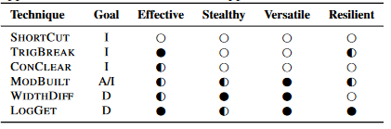

Anti Debugging Techniques
Impeding Analysis
ShortCut
  Prevents Access by intercepting shortcuts
TrigBreak
  Triggers Breakpoints during Debug
ConClear
  Clears the Console Window while running
Altering Behavior
ModBuilt
  Redefine the built-in functions
Detection
WidthDiff
  Using browser width vs website width
LogGet
  Call a function with a log that only runs while logging
MonBreak
  Time elapsed by a breakpoint
NewBreak
  New breakpoints added using time elapsed
Console Spamming
  Spams console and uses time elapsed

Slide 4
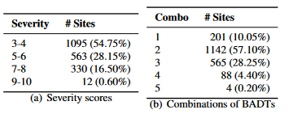
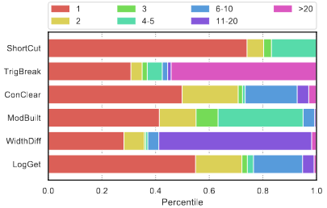
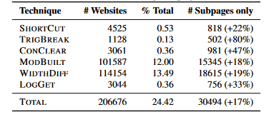
Study 1
Methodology
  Visited 1 million sites using 80 crawlers with Chromium and waited 30 seconds
  Injected code that would detect if these anti-debugging techniques
Prevalence
  Most Common Techniques
    ModBuilt and Width Diff
Severity Score
  Confidence Score
    Percentile²
  Inverse frequency of technique
  Sum all Techniques
Combinations
  Almost 90% of the top 2000 severe sites use multiple anti-debugging techniques.

Slide 5
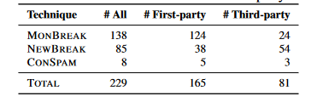
Study 2
Methodology
  Deterministic Web Replay
    Reloads the same page on a local proxy.
    Uses a set time and replacing Math.random implementation
  Code Convergence
    Reruns the code continually until no new code is executed
  Detection
    Compare if parts of convergent code did not ran after introducing debugging artifacts
Implementation
  Only visited 2000 websites with highest severity due to computation costs
  Replayed each website until either 50 tries or 10 tries with no code changes
  Test Each Technique 5 times and it exists if the majority are different than baseline
Prevalence
  229 sophisticated anti-debugging techniques found
  MonBreak was most common
  Basic anti-debugging techniques are indicators of advanced techniques.

Slide 6
Discussion
Not all anti debugging is malicious.
  Can also be used to help protect intellectual property.
Limitations:
  Completeness
  False Positives and False negatives
Future Work:
  Forensic Browser
All graphs are from: https://www.usenix.org/system/files/sec21-musch.pdf

