Slide 1

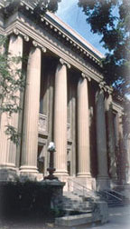
Csci 5980 Special Topic: Storage Systems for Supporting Big Data Applications
Spring 2020
David Hung-Chang Du
Qwest Chair Professor
Computer Science and Engineering
University of Minnesota
du@cs.umn.edu
CRIS: NSF I/UCRC Center on Intelligent Storage

Slide 2
Class Information
http://www-users.cselabs.umn.edu/classes/Spring-2020/csci5980/
Lecture Notes
  Posted on website a week before the class
Bulletin Board
  Participate in the discussions actively
Announcements
  Check the web page periodically
Notes:
Please take a note of the class website. All the class information is available on this web site. We will be posting lecture notes on the web at least a day before the class. We plan to minimize the amount of material handed out in the class. So please check the web site and print the relevant material before coming to the class.
We have a bulletin board for the class. Please post all your general questions there. So that others can also answer and benefit from the replies. You can also initiate any interesting discussions relevant to the course. Please participate in the discussions actively.
Also there is an announcements section where we will post all the notices. Things like availability of new material on the site. Please check the web page periodically.

Slide 3
Research Subjects Covered
Storage Technologies: Non-Volatile Memory (NVRAM), Solid State Drive (SSD), Shingled Magnetic Drive (SMR), Interlaced Magnetic Drive (IMR), Kinetic Drive, Object-Oriented Storage, and Tape Drive
Storage Systems: Key-Value Store, Tiered Storage, Software-Defined Storage, and Cloud Storage

Slide 4
Research Subjects (Cont.)
File Systems and Special Designed File Systems
Big Data Processing: In-Memory Processing, Big Graph Processing
Big Data Applications: Data Deduplication, Data Archive, and Long-Term Data Preservation,
Future Trend: Hyperconverged Infrastructure, SDS+SDN, and AI&ML for Data Management

Slide 5
Class Emphases
Research Experiences
Thinking Skill and Knowledge Acquization
Class Interactions
Research Report

Slide 6
Research Basics
Technology Trend
Application Trend
Evolution of Systems
Understand the overall picture
Identify new issues with sound motivations
Formulate the problem and propose solutions
Verify or validate your findings

Slide 7
Class Phases
Introduction to the subjects (3 to 4 weeks)
Initial report by groups: subject survey and problem definition (2 weeks)
Continue Discussion of Research Subjects (6 to 7 weeks)
Proposed issues and solution approaches (2 weeks)
Final Project Presentation (2 weeks)

Slide 8
Course Requirement and Grading
Final Exam: 40%
Project Report and Presentation: 40%
Class Participation: 20%

Slide 9
Group Participation
Each group consists of 1 or 2 students
Roughly the same number of groups on each subject (?)
Peer review (evaluation) by each group on the other groups (count for 30% of the report score)
Each group is required to provide concrete comments and ranked evaluation
Instructor evaluation count for 70% of the report score

Slide 10
Final Report Evaluation
Due on May 4th, 2020
Originality and Novelty: 20%
Effort and Completeness: 50%
Well-Written: 30%

Slide 11
Outline
New Computing and Communication Environment
Challenges of Facing The New Environment
Storage Technologies/Devices: NVRAM, Flash Memory Based Solid State Drives, Shingled Magnetic Disks, Interlaced Magnetic Drives, Kinetic Drives, and Tape Drives, DNA-Storage
Storage Systems: Tiered Storage, File Systems, VM & Containers, Archive Systems, and Cloud Storage, Hyperconverged Infrastructure, SSD+SSN
Applications: Big Data Processing (In-Memory), Key-Value Store, Data Deduplication for Backup, AI&ML for Data Management
Conclusions

Slide 12
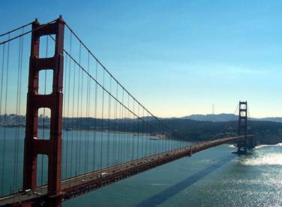
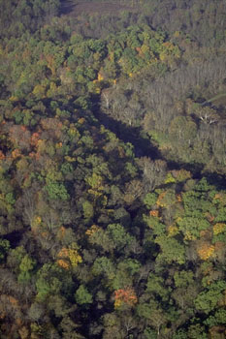
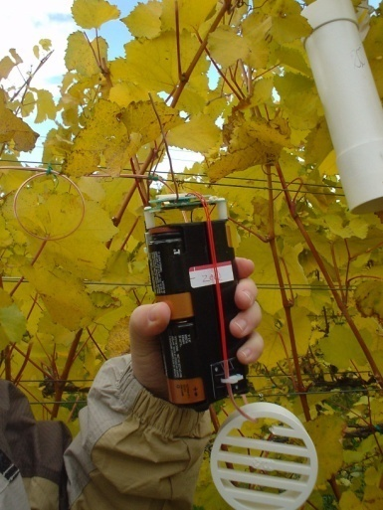
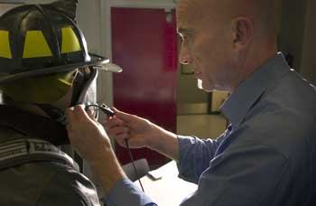
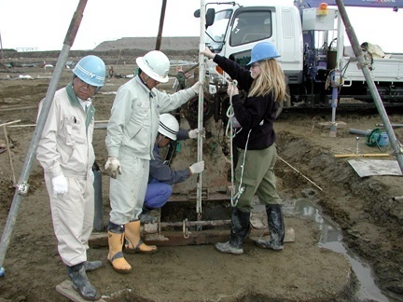
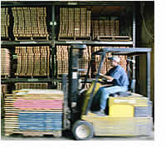
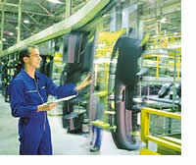

Instrument and Connect the World !
Bridge Monitoring
Building
  Environment
  Controls
Earthquake
  Monitoring
Elder Care
Factories
Fire Response
First Responders
Forest Management
Soil Monitoring
Supply Chain
Wind Response
… and more more

Slide 13
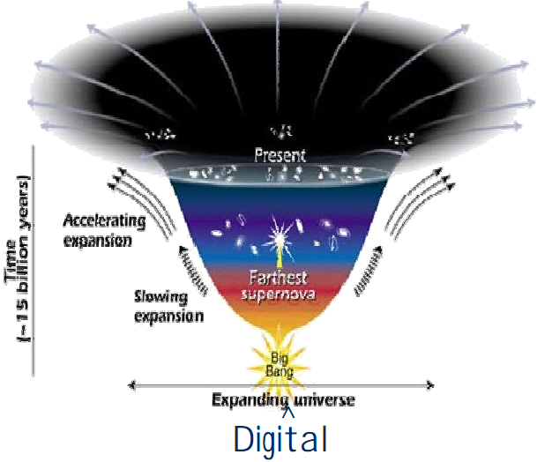
Digital Explosion: Data Centric
The digital universe will grow over six-fold, from 281 exabytes in 2007 to 1,773 exabytes in 2011
> 90% of the information in the digital universe is unstructured and absolute # of files growing faster than the TBs
----from IDC Survey presented in ISW 2008

Slide 14
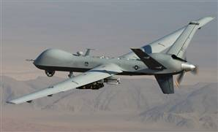
More Examples
1. Surveillance video data collected by Air Force drones
  One year’s collection requires 24 years’ processing (NYT, January 10, 2010)
2. Analog TV broadcasting becomes digital
3. Surveillance video cameras are widely deployed

Slide 15
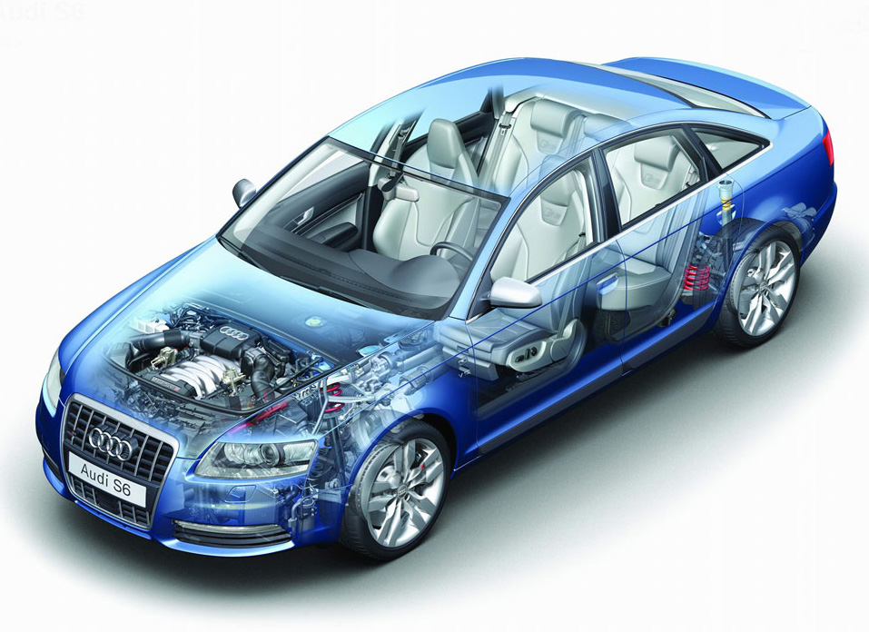
We Are Collecting All Kinds of Information
Indoor/outdoor temperature sensors
Passenger Occupancy
Fuel level
Seat belt tension
Oil sensor
Rain sensor
Water coolant temperature
Oxygen sensor
Accelerometer
Parking sensor
Speedometer
Odometer
Tachometer
GPS
Tire pressure monitor
Radar sensor
Anti thief sensors
Wheel speed

Slide 16
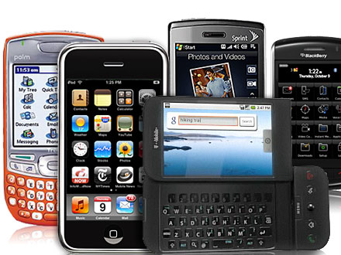
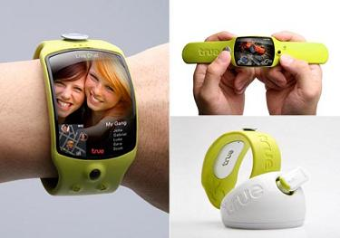
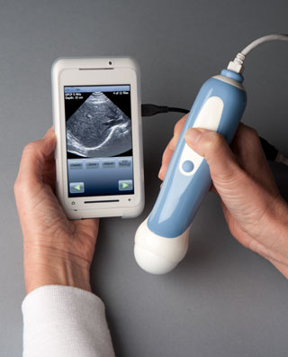




Rapid Evolution of Mobile Devices and Applications (More Data)
Notes:
At the same time, we have seen a rapid evolution of mobile devices and applications. Mobile devices have transformed from limited embedded systems to highly capable general purpose computing devices, such as smart phones, running on mobile platform such as Apple’s OS X, Google’s Android, and Microsoft’s Windows Mobile.
Everyday, there are mobile apps being introduced - We perhaps have already get used to use weather channel mobile apps, google maps to check real time traffic condition, read CNN the 5 things to know to start your day… Trip advisor, Yelp to find a restraurant, Fandango to find a movie to watch…

Slide 17
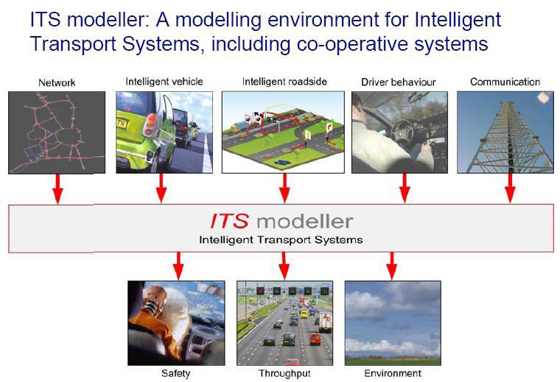
Research Methodologies Are Rapidly Changing

Slide 18
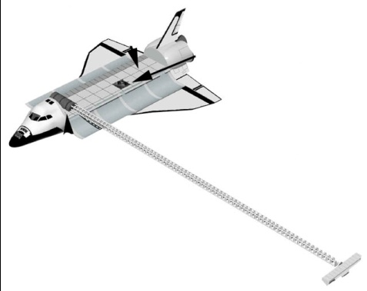
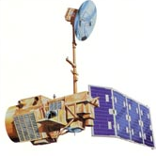
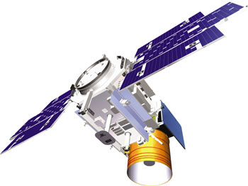
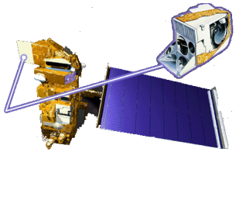
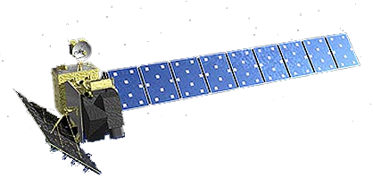
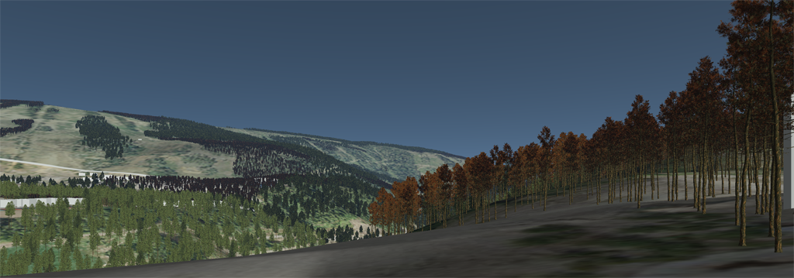
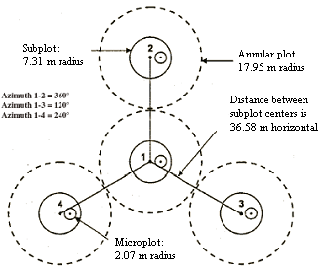
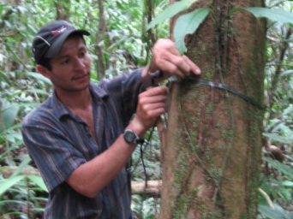
NASA Satellite and In Situ Observations
LANDSAT
ICESat
SRTM
MODIS
ALOS PALSAR
USDA FS, FIA Data

Slide 19
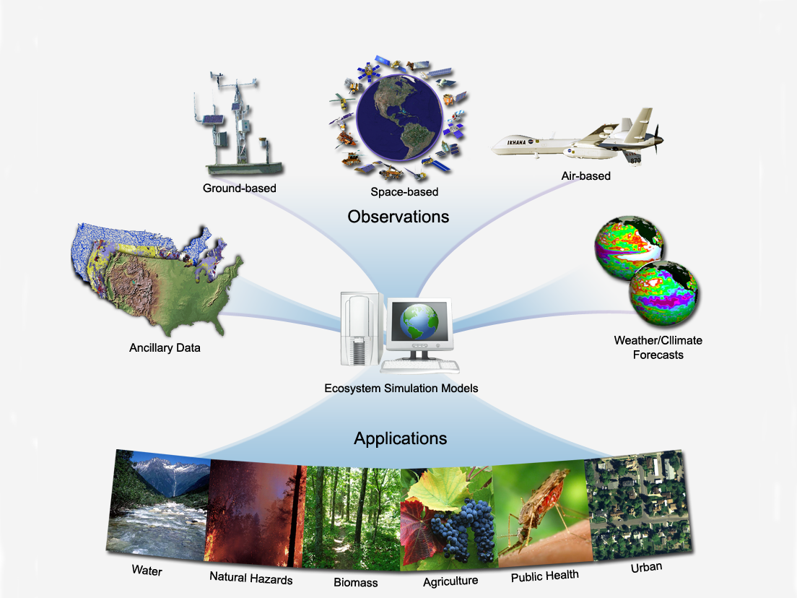
Ecological Forecasting predicting the effects of changes in physical, chemical, and biological environment on ecosystem state and function
Terrestrial Observation and prediction system (TOPS)
A data - modeling system for integrating satellite, surface data with simulation models
to produce ecological nowcasts and forecasts
Key elements:
Collect & Extract Data
Monitoring
Modeling
Forecasting
Local to Global
Focus on biogeo-
chemical cycles
Nemani et al., 2009, RSE

Slide 20
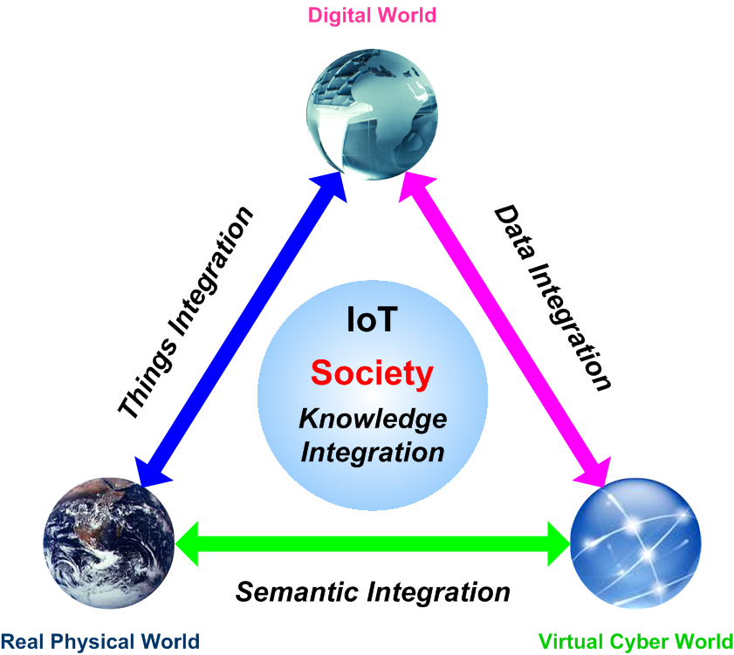

Slide 21
Information Based Medicine will require unprecedented access to diverse, integrated information
Challenges
Volume and complexity of data
Integrating massive volumes of disparate data
Need for sophisticated analytics
Growing collaboration across ecosystem

Slide 22







IBM Healthcare and Life Sciences Clinical Genomics Solution Conceptual Architecture
Medical Research
Clinical Care
Data Mining/Statistical Analysis/Visualization
Expression, SNPs, Clinical Studies & Trials, Proteomic
HIS, RIS, CIS, Pathology, Rx, Patient Charts
Adherence to Standards
HL7, BSML/HapMap, CDISC/ODM, MAGE-ML, CDA, etc.
WebSphere
Medical Information Gateway
Deidentification of Patient Data & Anonymous Global Patient Identifier Assigned
DB2 Information Integrator
Medical Information Repository
Medical Information Broker
Source scientific data & unstructured text files
e.g. MS Access. MS Excel, EST/ GenBank, XML, Medline, dbSNP

Slide 23



A Big Data Journey…
Segmentation coming to focus.. but still evolving..
ETL Offload
Event Processing
Archival
In Memory Analytics
Deep Learning

Slide 24
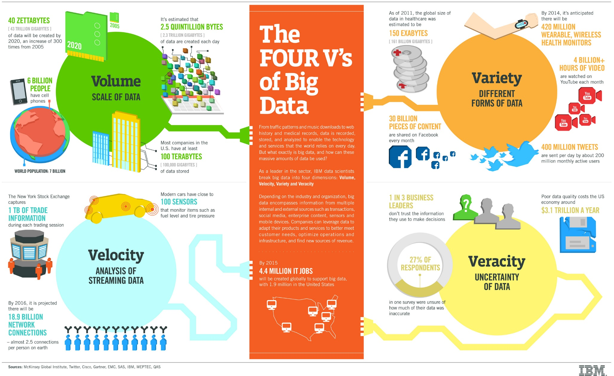
4 Vs of Big Data

Slide 25
Current Effort on Big Data
Flexible & Fast Processing: In Memory Processing
Multiple Data Sources: Data Steaming
Decision Making vs. Querying: Machine Learning Approach
Identifying Useful Information on Storage : active storage devices: exhaustive search?
Long-Term Data Storage: New Archive Architecture?

Slide 26
The Data Centric Future of IT
What will it look like?
HPC
Cloud
Cloud
Enterprise
Data Center Future

Slide 27


























The Changing Storage Landscape:
Services
Big Data
Software
Cloud
Systems
Software Defined Storage
Devices
Open Source
Components
Source: Seagate presentation

Slide 28

Expands I/O Stack to Fit Various Needs
1-2 PB/sec
Residence – hours
Overwritten – continuous
Host server based memory architectures- DRAM, 3D Xpoint
Memory
3PB DRAM
4-6 TB/sec
Residence – hours
Overwritten – hours
Host based PCIe cards moving to Shared NVME
Burst Buffer
6-8PB
Data Movement Management
1-2 TB/sec
Residence – days/weeks
Flushed – weeks
Parallel File System
80-100PB
PFS based systems with high performance SAS disk
100-300 GB/sec
Residence – months-year
Flushed – months-year
High Perofrmance Storage
300-500PB
Object based high capacity systems/disks (SATA) – Active Archive
10s GB/sec (parallel tape)
Residence – forever
Tape
New TAM Expansion Opportunity
Archive
10EB

Slide 29
Challenges in the New Environment
Network is no longer just end-to-end
Data is no longer just structured
Drowning in Data; Loss in Internet
A New Internet Architecture Is Required
Data -> Information -> Knowledge
Data/Network Security
Data/Information Privacy
Long-Term Data Preservation
Scalability (Internet, cloud storage and exascale computing)

Slide 30
More Challenges
How to model dynamically changed data relationship?
  Relationship can be changed by an event
  Relationship can be changed by situations
  Relationship can be changed by interests
How to make network to be situational-aware?
How to integrate data delivery with dynamically changed situations/interests/events?
How to decide data to be sent (to whom?), to be stored (for how long?) and to be dropped?

Slide 31
Intelligent Storage based on Object-based Storage Devices (OSD)
Exploited to store and retrieve data more efficiently with Indexing/Search capability
Knowledge
Captured in the attributes of an object
Information
[ INTELLIGENCE ]
Objects
← Extended attributes augmented view high level semantics associated.
Files
Blocks
← Traditional storage device view - raw bits, no associated semantics.

Slide 32

Intelligence on the Drives
Magnetic storage /Solid State Storage
Processor & DRAM
SAN/IP attachment
Execution environment
Semantic-aware
Application-aware
Object storage device
Search and indexing
Query and response
Applications
Services
DBMS
RPC, ...
File System
SAN driver
Disk driver
OS Kernel
Data+Data Semantic, Data Location Transparency, Storage Layer Reduction

Slide 33
Thank You!
Questions?

