Slide 1
LevelDB Introduction
Fenggang Wu
Oct. 17th, 2016

Slide 2
Projects Using LevelDB

Slide 3
LevelDB
“LevelDB is an open source on-disk key-value store written by Google fellows Jeffrey Dean and Sanjay Ghemawat.” – Wikipedia
“LevelDB is a light-weight, single-purpose library for persistence with bindings to many platforms.” – leveldb.org

Slide 4
API
Get, Put, Delete, Iterator (Range Query).

Slide 5
Outline
Design
  From LSM Tree to LevelDB
Implementation

Slide 6
Key-Value Data Structures
Hash table, Binary Tree, B⁺-Tree
"when writes are slow, defer them and do them in batches” *
*Dennis G. Severance and Guy M. Lohman. 1976.

Slide 7
Log-structured Merge (LSM) Tree
O’Neil, P., Cheng, E., Gawlick, D., & O’Neil, E. (1996).

Slide 8
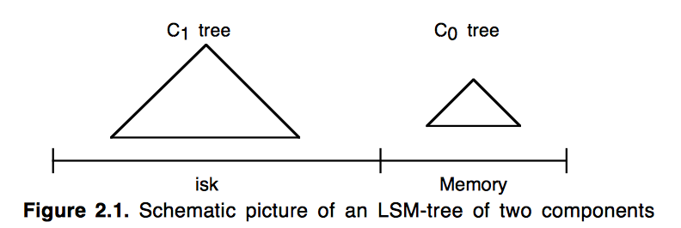
Two Component LSM-Tree

Slide 9
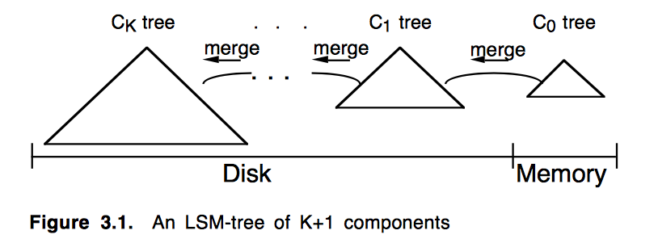
K+1 Components LSM-Tree

Slide 10
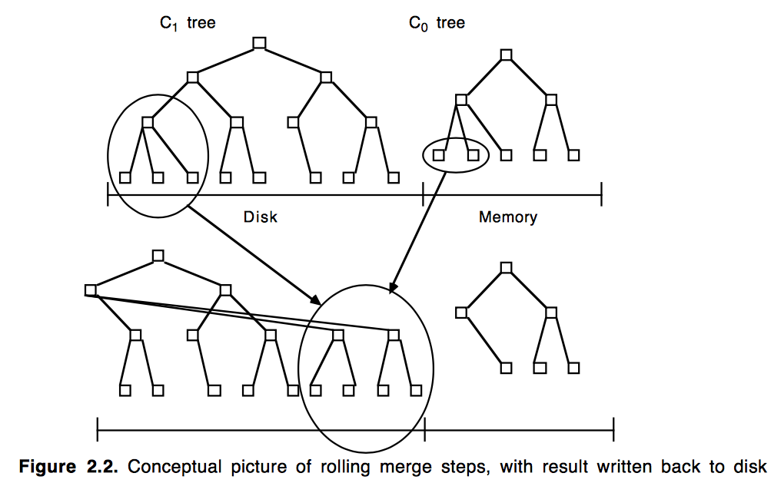
Rolling Merge

Slide 11
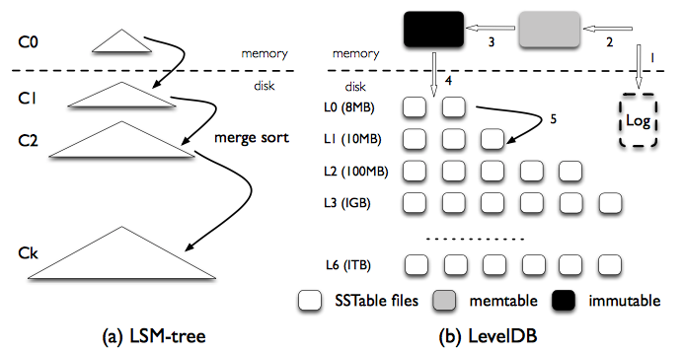
From LSM-Tree to LevelDB
Lu, L., Pillai, T. S., Arpaci-Dusseau, A. C., & Arpaci-Dusseau, R. H. (2016).

Slide 12
LevelDB Data Structures
Log file
Memtable
Immutable Memtable
SSTable (file)
Manifest file

Slide 13
Discussion
Why using files instead of tree structure on disk?

Slide 14
Operations
Put/delete
Get
Compaction

Slide 15
Put/Delete
Insert into memtable
Delete: Insert a delete marker to the memtable; annihilates with the value during compaction.

Slide 16
Get
Sequence: memtable => immutable memtable => SSTs(level# low to high)
Using manifest file (which records smallest and largest key), to locate all the overlapping SSTs.

Slide 17
LevelDB Structural Requiement
level: 0~7
L0 table size: ~4MB. Number: ideally 4; try to be less than 8; no greater than 12
L1 (and above) table size: <2MB. Total size < 10^i MB (i=level).

Slide 18
Compaction
Maintain levelDB structure “in shape”
Minor Compaction
Major Compaction

Slide 19
Minor Compaction
  Dump immutable into SST file
Push as further down as possible if
  No overlap with current level
  Overlapping with no more than 10 SSTs in the next level

Slide 20
Trigger Minor Compaction
when all of the below satisfy:
  memtable exceeds 4MB when put/delete
  immutable = NULL
Block write thread, move memtable to immutable, create new memtable.
Background flushing for immutable

Slide 21
Major Compaction
Pick one SST (level i) using an PickCompaction function.
Merge it with all the overlapping SSTs (level i or i+1) and write them into level i+1
File boundary: 1) size <=2MB and 2) overlapping with no more than 10 SST in the next level

Slide 22
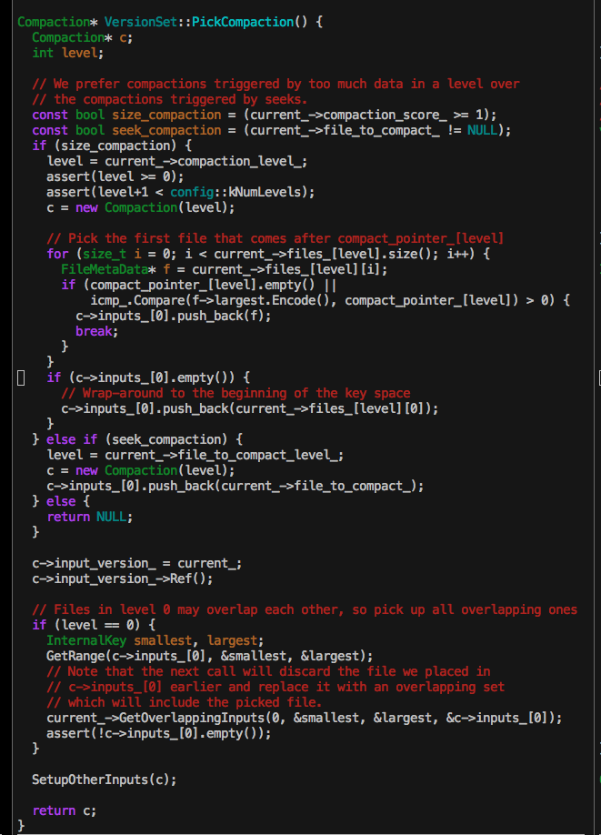
Evaluating Function
size_compaction
  Find more imbalanced level
  Find the next SST to be compacted
seek_compaction

Slide 23
Trigger Major Compaction
when any of below satisfies
  Invoke CompactRange() manually
  allowed_seek used up when calling Get()
  L0 SST exceeds 8
  Li (i>0) SST space exceeds 10^i MB

Slide 24
More Implementation Details

Slide 25
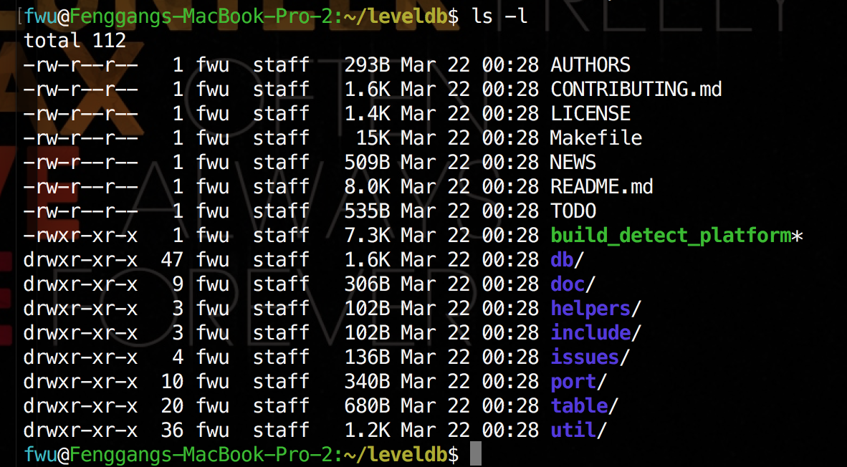
Source code structure

Slide 26
Important Directories
doc/ documentation. Define log and sstable format
include/leveldb/ header file for users, including basic interfaces, etc.
db/ main key value store logic implementation. including interface implementation (db_impl/db_iter), internal struct definition (dbformat/memtable/skiplist/write_batch), db status and operations (version_set/version_edit), log formatting (log/log_reader/log_writer), file operations (filename), sstable related files (builder/table_cache).
table/ sstable data structure and operations, including format, block operations (block/block_builder), iterator(two_level_iterator/ merger), optimizing wrapper (iterator_wrapper)
port/ portable implantation for lock, signal, atomic operations, compression. (posix and android)
util/ utility. memory management for memtable; LRU cache; comparator, general functions (coding/crc32c/hash/random/MutexLock/logging), etc.

Slide 27
Basic Concepts

Slide 28
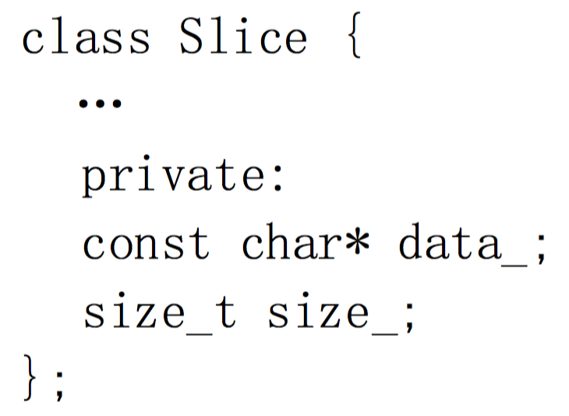
Slice (include/leveldb/slice.h)
Notes:
An wrapper of data and the length for the ease of managing data.

Slide 29
Option (include/leveldb/option.h)
struct options: Configuration when db is started.
  write buffer size (memtable size)
  log size
  max open file number
Also there are ReadOption/WriteOption for put/get/delete.
  sync, etc.

Slide 30
Some other “knobs”
max level number
kL0_CompactionTrigger: L0 table compaction trigger
kL0_SlowdownWritesTrigger
kL0_StopWritesTrigger
kTargetFileSize

Slide 31
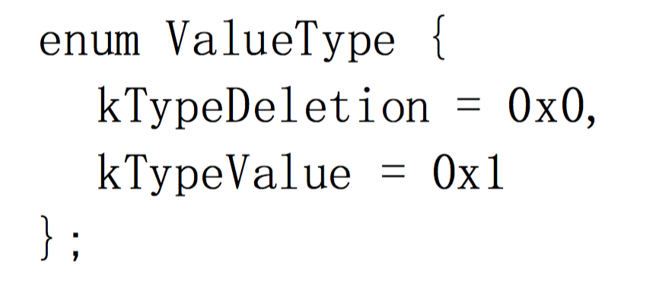
ValueType (db/dbformat.h)

Slide 32
SequnceNumber (db/dbformat.h)
every put/delete operation has a sequence number (64bits global variable)
compaction, snapshot depends on the sequence number.

Slide 33
Keys
userkey: passed from user, in Slice format
InternalParsedKey: userkey + seqNum + valuetype
InternalKey: string representation of InternalParsedKey

Slide 34
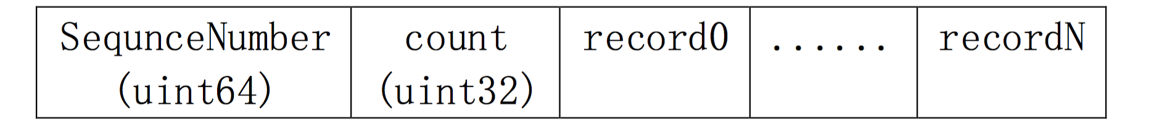
WriteBatch (db/write_batch.cc)

Slide 35
Memtable(db/memtable.ccdb/skiplist.h)
write buffer of the keys (size: write_buffer_size)
format: skip_list
Once size read threshold, it turns into imutable memtable, and a new buffer is create for write.
Background compaction will dump immutable table to sstable.

Slide 36
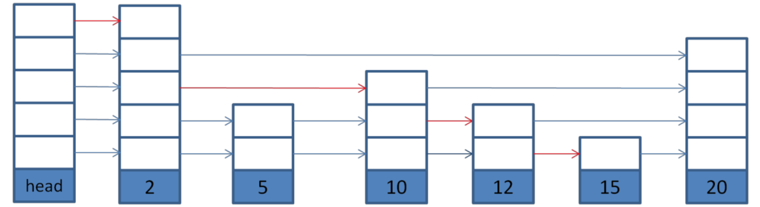
Skip list

Slide 37
Sstable(table/table.cc)
Persistent data store (Key and value).
index in the end of the file
max file size: kTargetFileSize

Slide 38
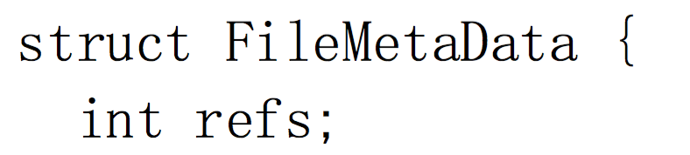
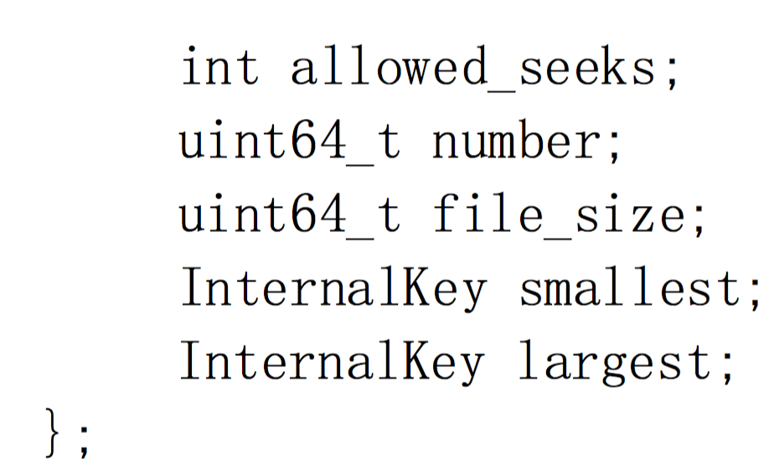
FileMetaData (db/version_edit.h)

Slide 39
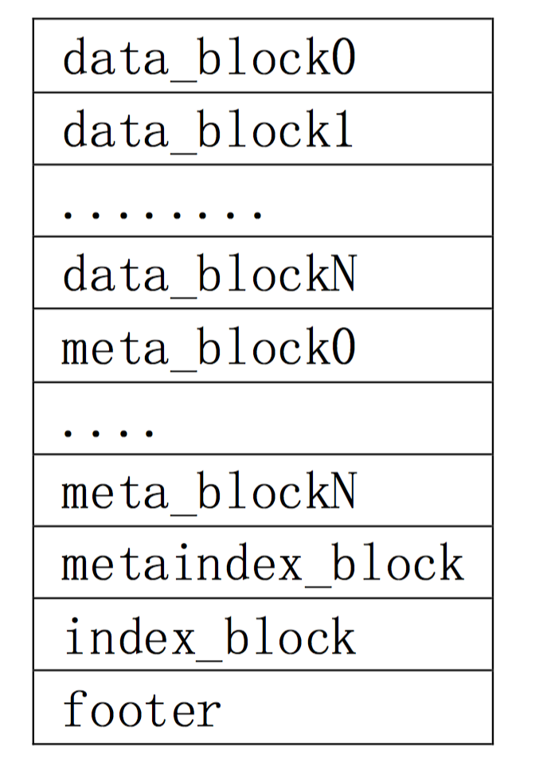
Sstable format
index
index

Slide 40
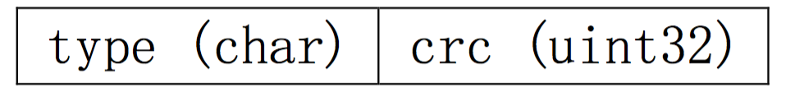
block
block(table/block.cc)
BlockHandle(table/format.h)
compressed?

Slide 41
Compaction
one compaction background process is in charge of dumping memtable into sstable, and balance sstable in all levels.
memtable dumping has priority.
  L0 table has the size of the write buffer. L0 table does not merge keys
According to design policy, selecting one table from level n and n+1 to merge (merge the same key, deletion), result in many sstables in level n+1.
L1 and up, sstable is non-overlapped, better for read operation

Slide 42
Compaction in Detail
leveldb has only one compaction background task.
After main thread trigger compaction:
1) if compaction is running or db is exiting, return
2) examine current db status to determine the need of compaction. If so trigger background compaction task
3) carry out compact logic (DBImpl::BackgroundCompaction()), trigger compaction again on completion.

Slide 43
When main thread trigger compaction?
db starts and after recovery is done
call compaction function directly
memtable reach to size limit, turn into immutable memtable and trigger
allowed_seeks is used up for a file.

Slide 44
Compaction procedure
If immutable memtable exists, dump it to disk, and return after done.
VersionSet::PickCompaction()
DBImpl::DoCompactionWork()
DBImpl::CleanupCompaction()

Slide 45
Minor Compaction Procedure
1. sstable = MemtableDumpToSSTable(immtable);
2. i = PickLevelForMemTableOutput(sstable);
3. place SSTable to level i;
4. edit= getVersionEdit();
5. updateVersionSet();

Slide 46
VersionSet::PickCompaction()
choose level (the one exceeds the file count limit most), choose the file with the start_key larger than the compaction pointer
if all level balanced, choose the file that exceed the seek time limit.

Slide 47
Major Compaction Procedure
c, i := PickCompaction(); // i is level
if( up(i).size() == 1 AND down(i).size() == 0) { // down(i) is empty set.
overlapBytes := calculateOverlapBytes(up(i), Level[i+2]);
if( overlapBytes <= 20M ){
Just place up(i) to (i+1) level. return; }
} DoCompactionWork;
edit = updateEdit(); updateVersionSet(edit);

Slide 48
References
http://leveldb.org
https://en.wikipedia.org/wiki/LevelDB
https://opensource.googleblog.com/2011/07/leveldb-fast-persistent-key-value-store.html
http://highscalability.com/blog/2011/8/10/leveldb-fast-and-lightweight-keyvalue-database-from-the-auth.html
http://openinx.github.io/ppt/leveldb-lsm-tree.pdf
https://github.com/google/leveldb
http://openinx.github.io/2014/08/17/leveldb-compaction/
http://openinx.github.io/2014/08/11/leveldb-notes/
https://www.quora.com/How-does-the-Log-Structured-Merge-Tree-work
http://blog.csdn.net/sparkliang/article/details/8567602
http://www.cnblogs.com/siegfang/archive/2013/01/12/lsm-tree.html
http://teampal.ustcsz.edu.cn/svn/nosql/test/tair/%E6%B7%98%E5%AE%9Dleveldb%E7%9A%84%E5%AE%9E%E7%8E%B0.PDF
Notes:
https://www.quora.com/How-does-the-Log-Structured-Merge-Tree-work

