Slide 1
DNA Storage
04/13/2020

Slide 2
Outlines
DNA storage overall structure
Encode/ECC code
Basic operations: synthesis and sequencing
Some existing works for DNA storage:
  DNA archive storage system
  OligoArchive for database system
  Puddle: A Dynamic, Error-Correcting, Full-Stack Microfluidics Platform

Slide 3
Basics
Nucleotides: molecules that form the building blocks of DNA.
  Adenine (A) ←→ Thymine (T)
  Cytosine (C) ←→ Guanine (G),
Naturally occurring DNA
  double helix with two strands of nucleotides
DNA for data storage: oligonucleotide (oligo)
  a sequence of nucleotides
  Synthetic/Artifical DNA: synthesized using a chemical process that assembles the DNA one nucleotide at a time.

Slide 4
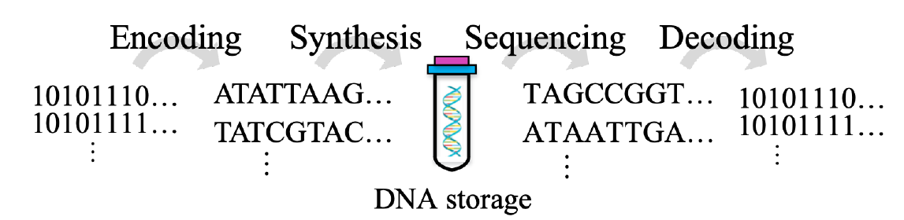
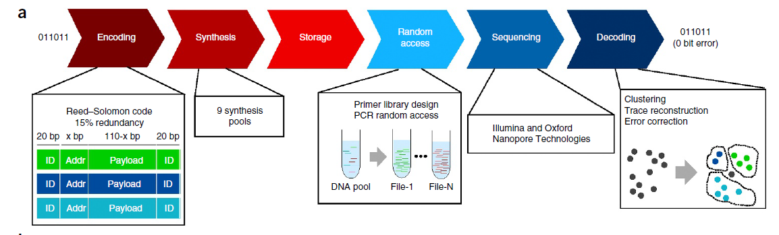
Overall structure of DNA storage
Organick, Lee, et al. "Random access in large-scale DNA data storage." Nature biotechnology 36.3 (2018): 242.

Slide 5
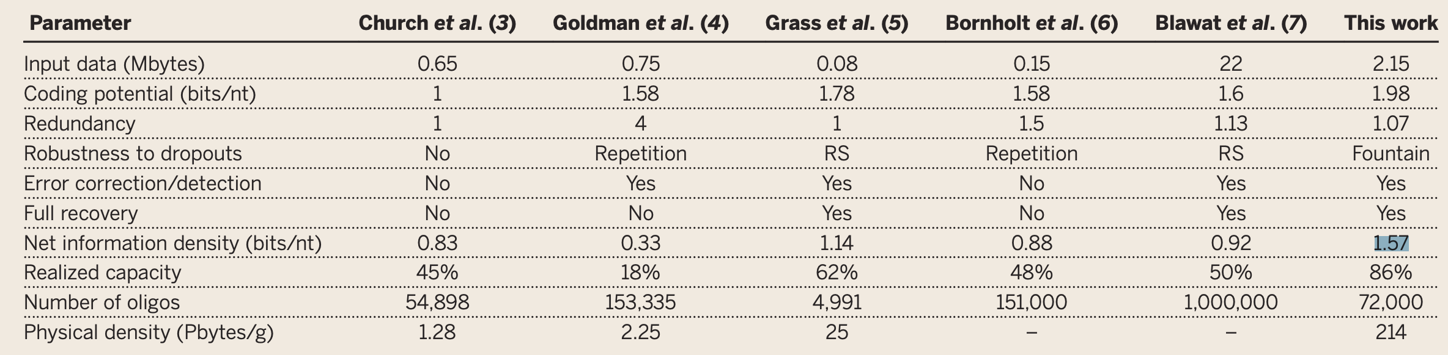
Encoding
Optimal Capacity/Density
  2bit/nt: 2 bits per base pair (BP is one pair of nucleotides)
  A = 00, C = 01, G = 10 and T = 11
Optimal density is just an ideal case:
  Biochemical limitation
    G•C base pair: harder to break -> less efficient PCR.
    homopolymer runs -> higher sequencing error rates. (e.g., AAAAAAAAAAATTTTTT)
  DNA strands not only contain payload information
    Primers
    Internal addressing/indexing
    ECC codes
Erlich et al., Science 355, 950–954 (2017) 3 March 2017

Slide 6
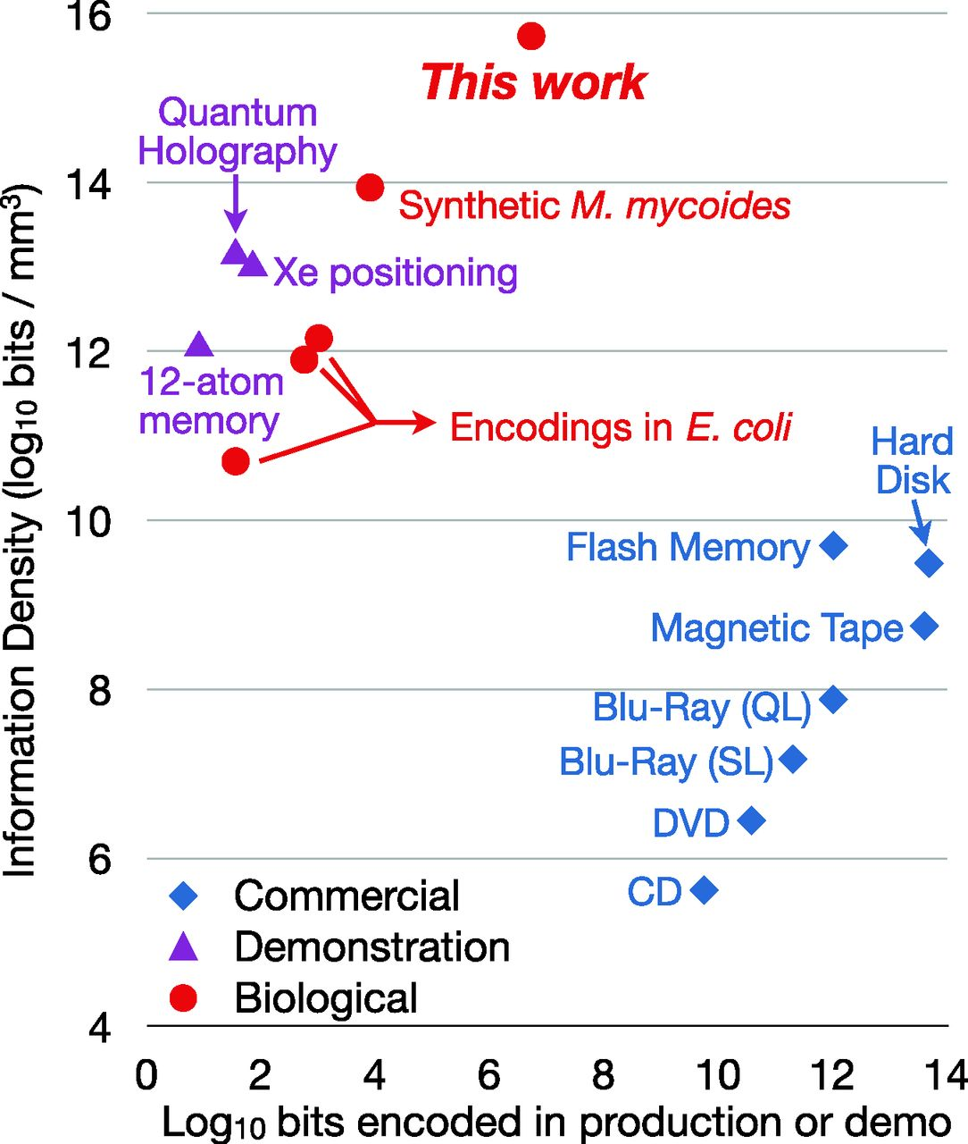
Encoding examples in DNA storage
Early Works (inefficient error-prone )
  Run number of 0 or 1.
  Morse code:
    (C = dot, T = dash, A = word space and G = letter space)
[Church’12]
  (A, C = 0 and T, G = 1)
George M. Church et al. Science 2012;337:1628

Slide 7
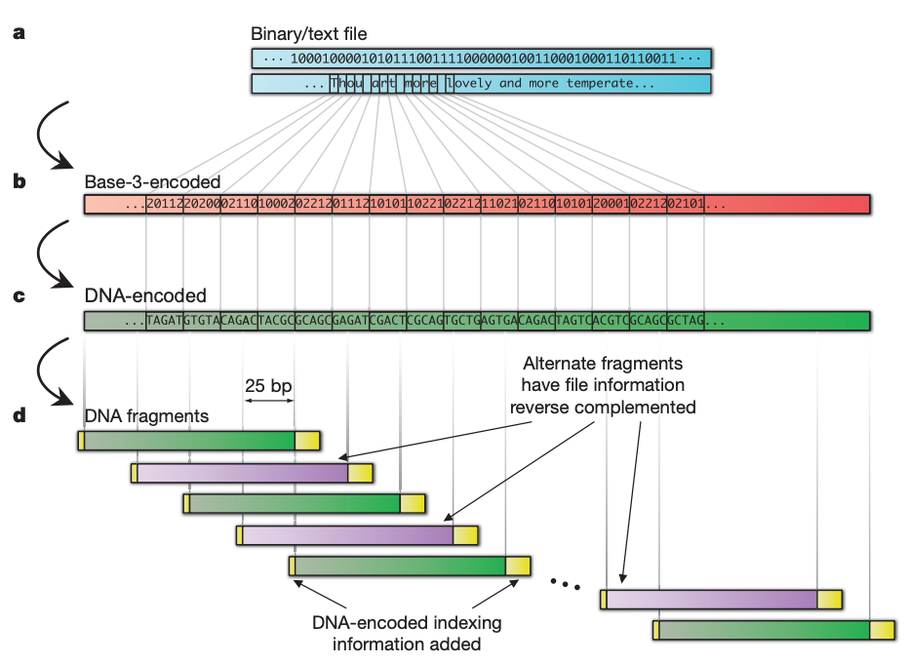
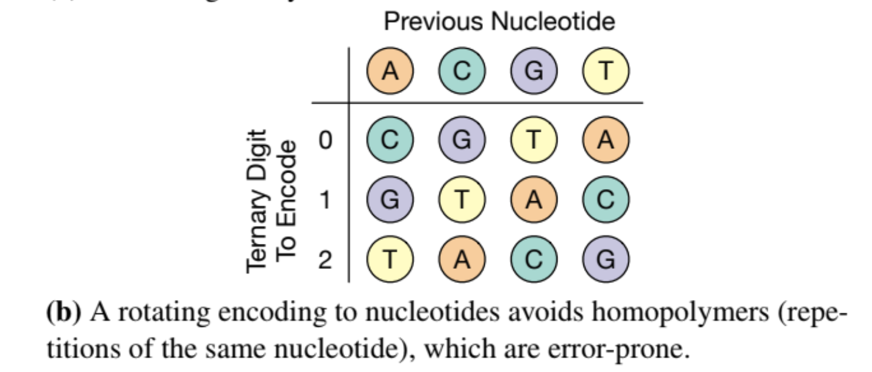
Goldman’13
Ternary code in combination with the Huffman encoding
Rotation Code
  Prevent homopolymers
Parity Check
Overlapping redundancy

Slide 8
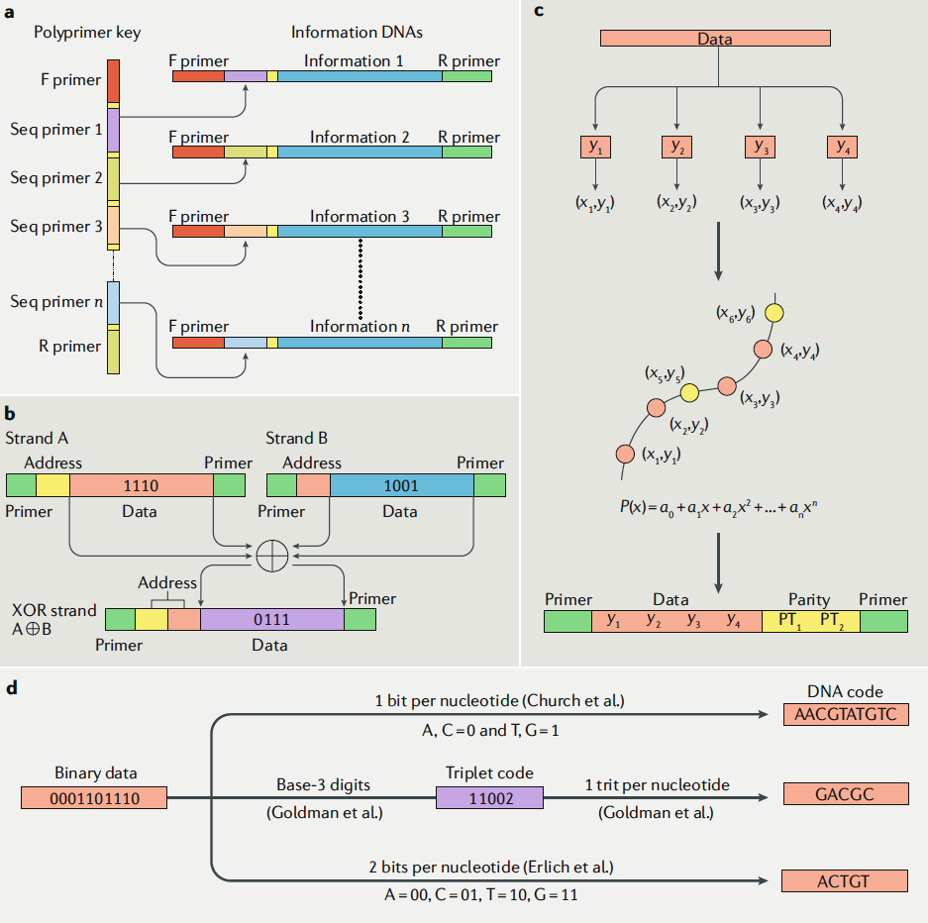
Error Correction
polyprimer key (PPK)
Reed-Solomon (RS) Code
Multiple Copy
XOR
Reed–Solomon codes
Huffman encoding
Fountain codes
Other codes:
  comma code, the comma-free code and the alternating code.
  encode words in a text -> rarely used.
Different Coding Strategy

Slide 9
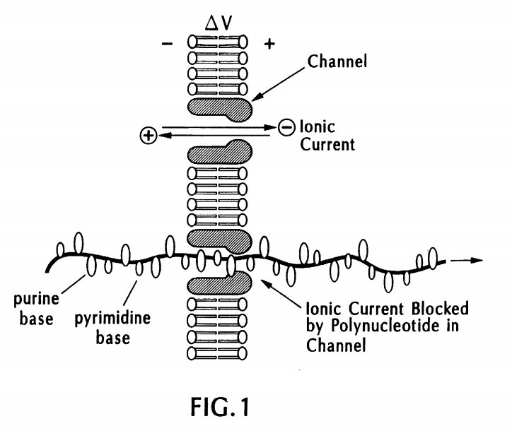
DNA Storage: Synthesis / Sequencing
Synthesis
  oligonucleotide arrays
  using a chemical process that assembles the DNA one nucleotide at a time.
Sequencing
  1st gen: division of a long DNA strand
  2nd gen: fluorescence-based detection and automated analysis
    require DNA template amplification -> error
  3rd gen: nanopore sequencing
    Real-time, single-molecule sequencing
Nanopore Sequencing: https://patentimages.storage.googleapis.com/34/ce/6b/21fc9150a93517/US5795782.pdf

Slide 10
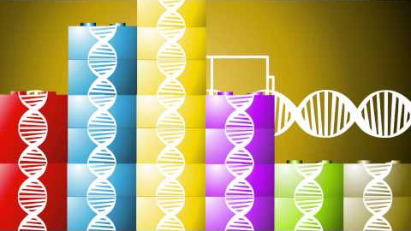
DNA Synthesis
https://www.youtube.com/watch?time_continue=3&v=rD5uNAMbDaQ&feature=emb_title

Slide 11
https://en.wikipedia.org/wiki/Polymerase_chain_reaction

Slide 12
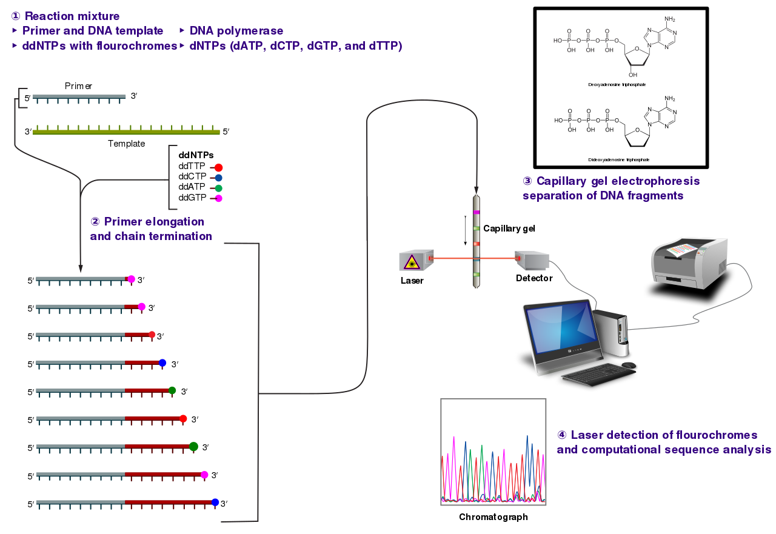
Sanger sequencing:
Notes:
capillary ['kæpəleri]
deoxynucleotide [diːɒksɪn'juːkliːəʊtaɪd]
dideoxynucleotide [di:diːɒksɪn'juːkliːəʊtaɪd]
fluorescent [ˌflɔː'resnt]

Slide 13
Limitations of DNA Synthesis/Sequencing
Data layout and random access
  Max oligo length: ranges from a few hundred to a few thousand nucleotides at best.
  No logical addressing like block-based disk and tape. Address should be encoded along
Synthesis & sequencing errors
  Synthesis: longer oligo more errors and truncated by products
  Sequencing: short-read -> more substitution errors; long-read inserts or deletes spurious nucleotides.
  Error correction code is necessary

Slide 14
A DNA-Based Archival Storage System
James Bornholt† Randolph Lopez† Douglas M. Carmean‡
Luis Ceze† Georg Seelig† Karin Strauss‡
† University of Washington ‡ Microsoft Research
ASPLOS’16
Presented by: Fenggang Wu
7/12/2019

Slide 15
Summary
Context: the exponential growth rate easily exceeds our ability to store it.
Opportunity: DNA is extremely dense and long lasting.
Problem: How to store and retrieve data based on DNA?
Solution: DNA-based archival storage system
  Key-value store. Random access.
  Evaluations using wet lab experiment and simulation.
  Demonstrate feasibility, random access, and robustness.

Slide 16
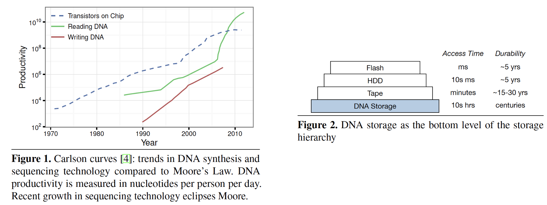
Motivation

Slide 17
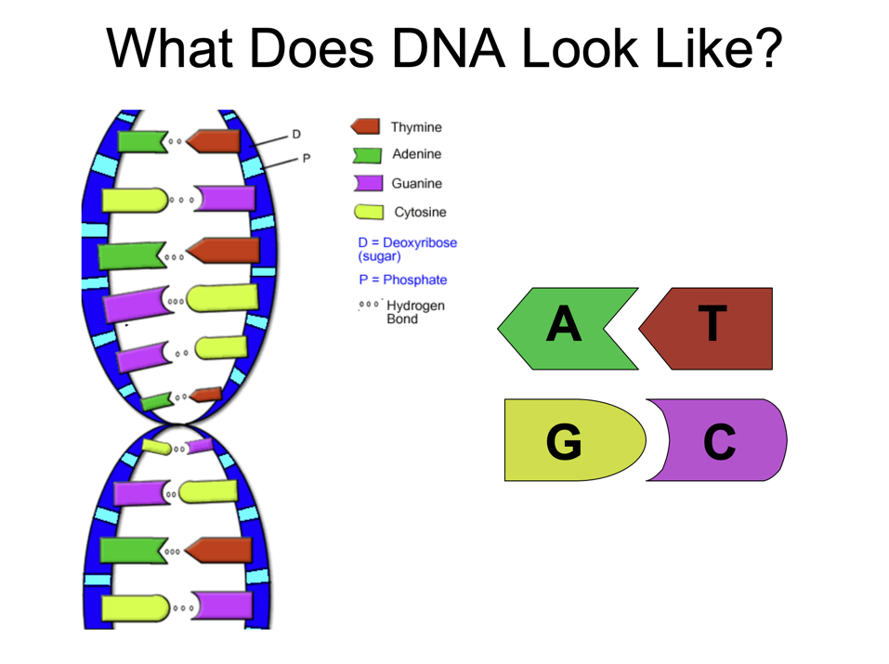
Background
DNA Basics
https://www.genome.gov/Pages/Education/Modules/BasicsPresentation.pdf

Slide 18
Background
PCR: polymerase chain reaction
PCR: a method for exponentially amplifying the concentration of selected sequences of DNA within a pool.
Primers: The DNA sequencing primers are short synthetic strands that define the beginning and end of the region to be amplified.

Slide 19
Background
DNA Synthesis
Arbitrary single-strand DNA sequences can be synthesized chemically, nucleotide by nucleotide.
Synthesizing error limits the size of the oligonucleotides (< 200 nucleotides).
  truncated byproducts
Parallel synthesize [1]: synthesize 10^5 different oligonucleotides in parallel.
[1] S. Kosuri and G. M. Church. Large-scale de novo DNA synthesis: technologies and applications. Nature Methods, 11:499–507, 2014.

Slide 20
Background
DNA sequencing
The DNA strand of interest serves as a template for PCR.
Fluorescent nucleotides are used during this sequencing process.
Read out the complement sequence optically.
  Read error. (~1%)

Slide 21
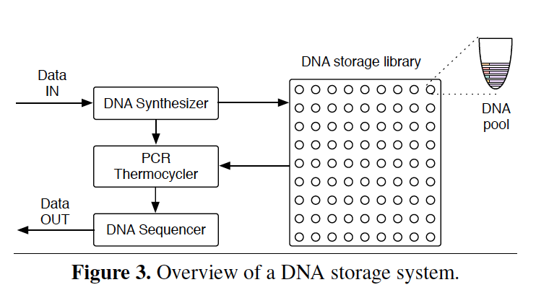
Overview
basic unit: DNA strand that is roughly 100-200 nucleotides long, capable of storing 50-100 bits total.
data object: maps to a very large number of DNA strands.
The DNA strands will be stored in pools
  stochastic spatial organization
  structured addressing: impossible
  address: embedded into the data stored in a strand

Slide 22
Interface and Addressing
Object Store: Put(key, value) / Get(key).
Random access: mapping a key to a pair of PCR primers.
  write: primers are added to the strands
  read: those same primers are used in PCR to amplify only the strands with the desired keys.
Separating the DNA strands into a collection of pools:
  Primers: reaction/limited number
  Error-prone.

Slide 23
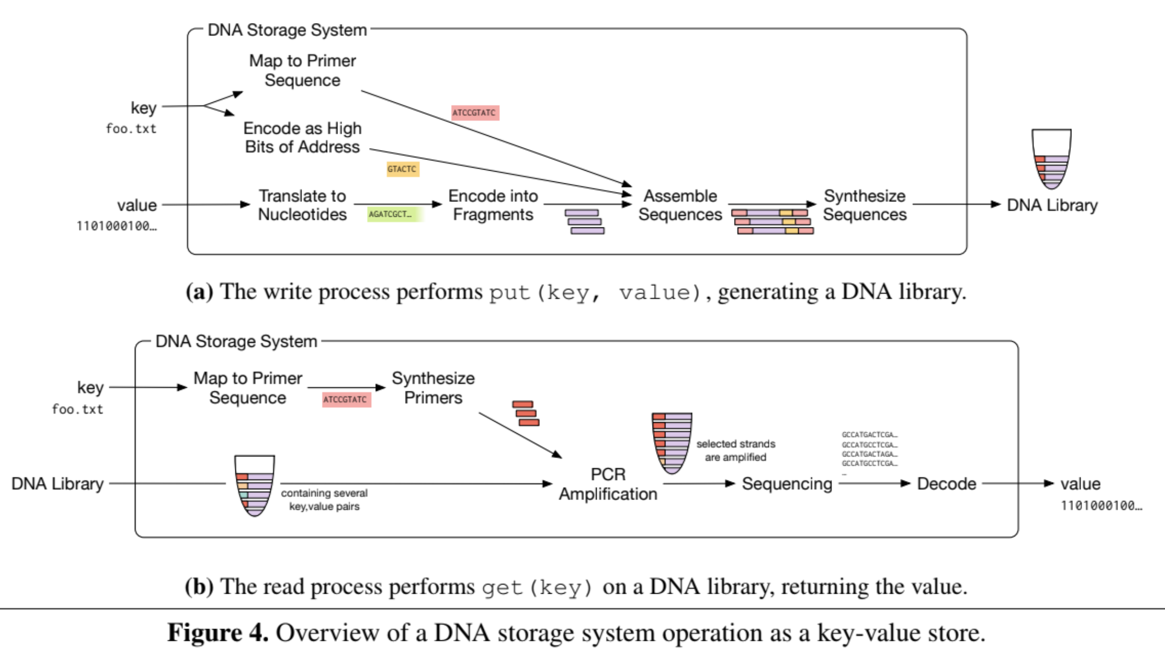
System Operation

Slide 24
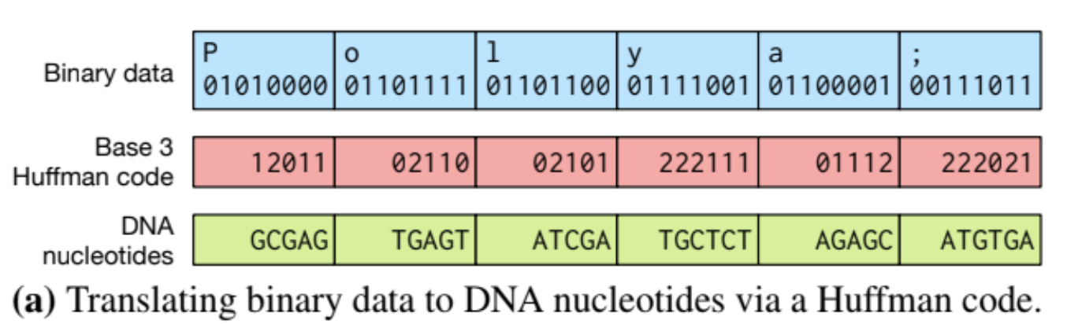
Encoding
Base 4 encoding: 00, 01, 10, 11 => A, T, G, C.
  Error prone: synthesis, PCR, sequencing (substitutions, insertions, and deletions of nucleotides)
Base 3 + Huffman code + rotation code

Slide 25
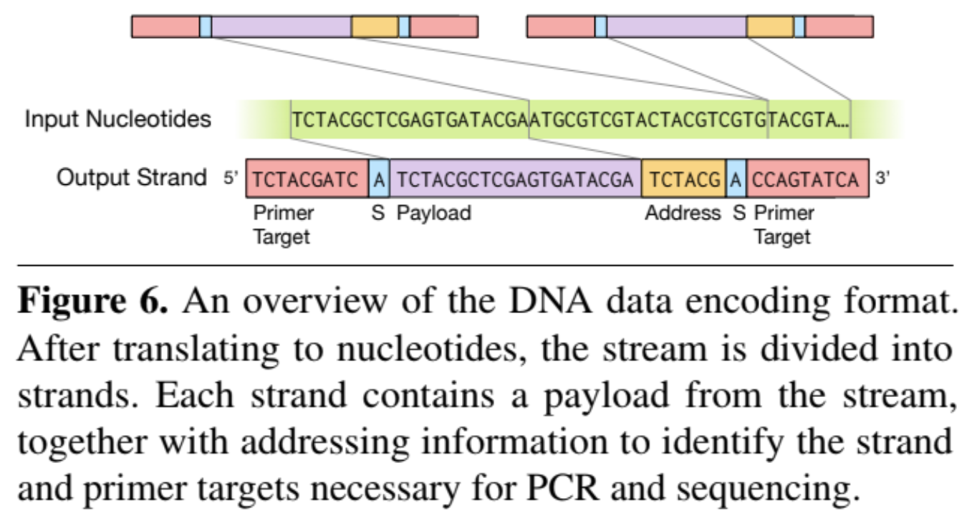
Data Format
To aid decoding, two sense nucleotides (“S” in Figure 6) indicate whether the strand has been reverse complemented (this is done to avoid certain pathological cases)

Slide 26
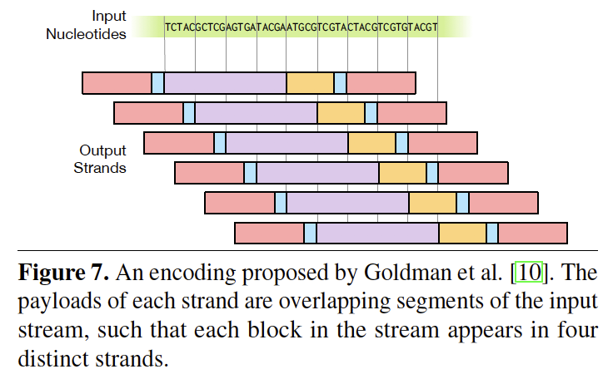
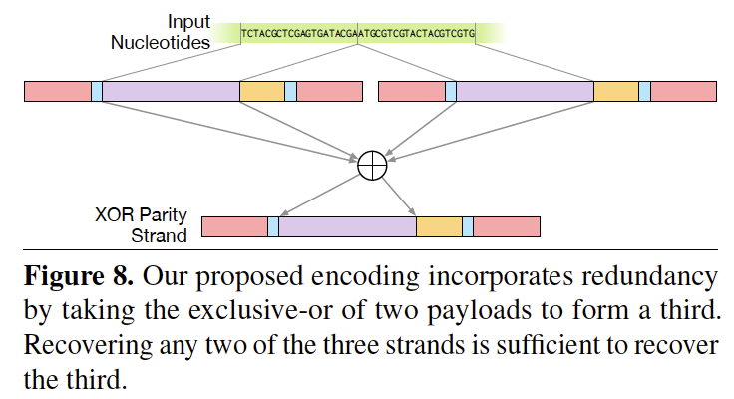
Adding Redundancy
Goldman Encoding
XOR Encoding

Slide 27
Other Factors
Primer effectiveness
Different error rate in the location of DNA strand
Tunable redundancy

Slide 28
Evaluation
Wet lab experiment
Simulation

Slide 29
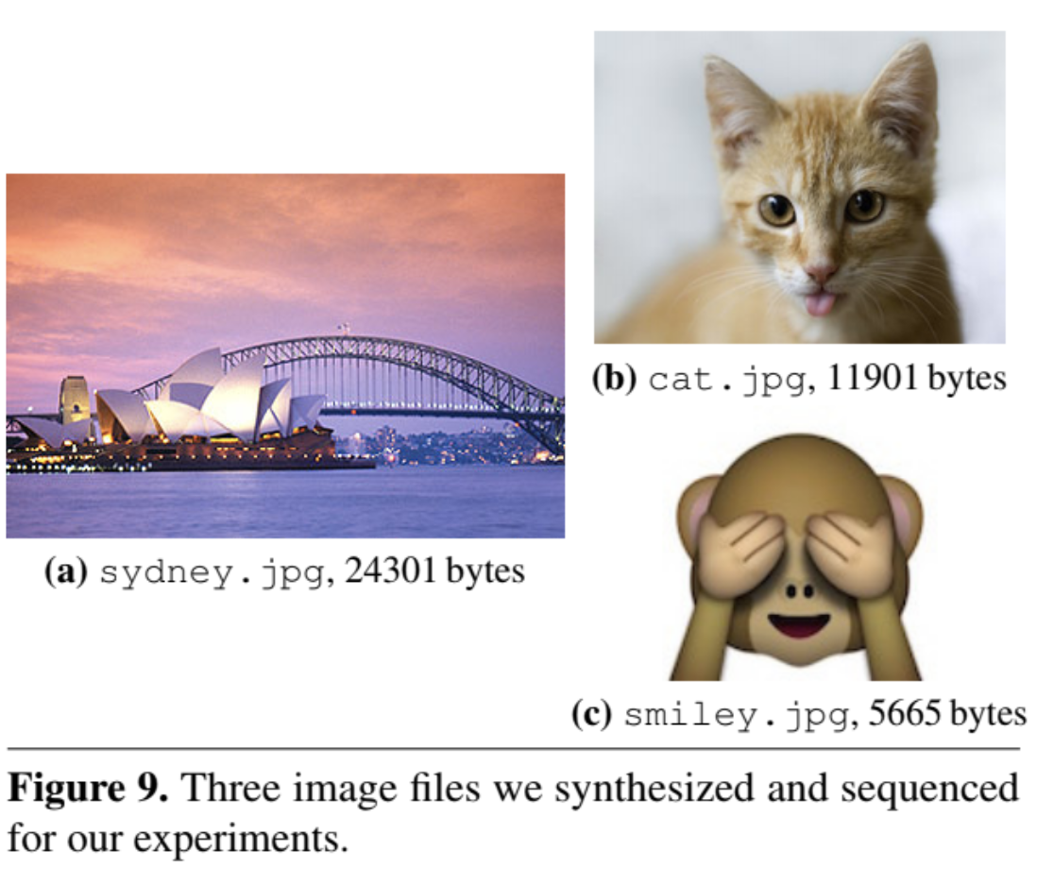
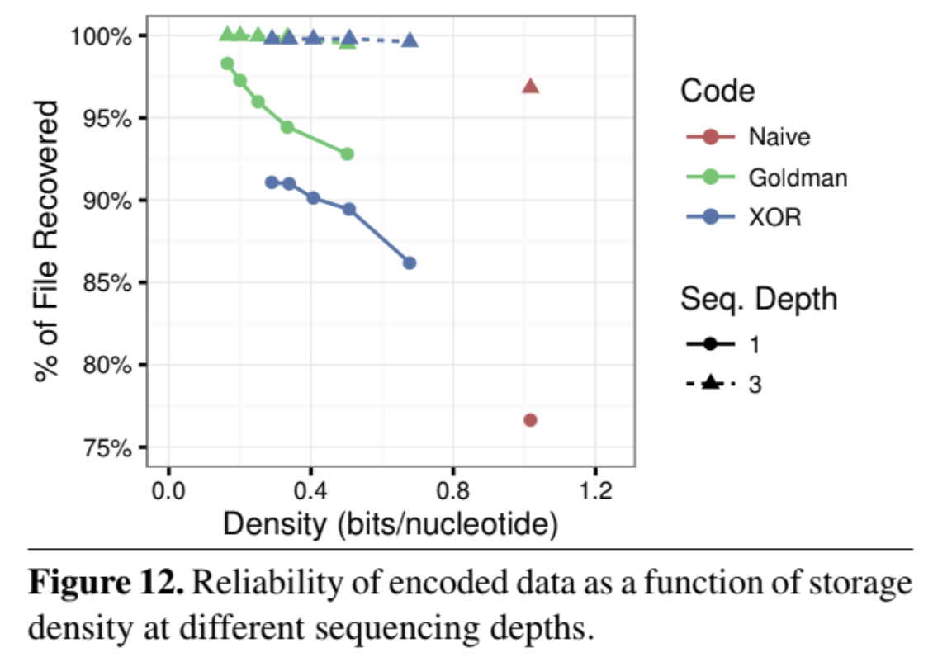
Experiment

Slide 30
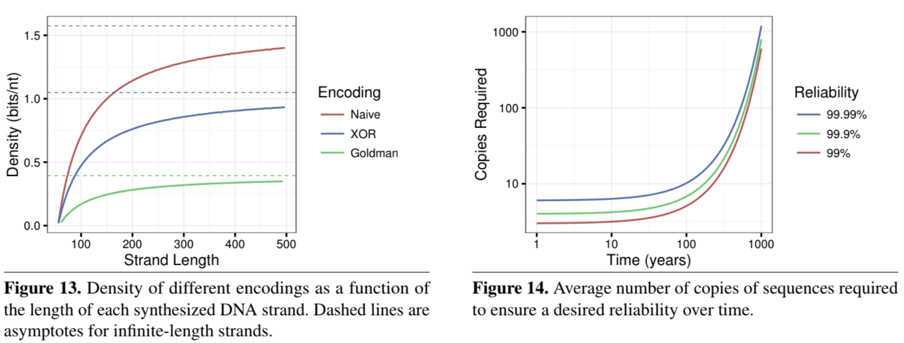
Simulation

Slide 31
Summary
DNA-based storage has the potential to be the ultimate archival storage solution: it is extremely dense and durable.
Background: Basics, Synthesize, PCR, Sequencing
DNA archival system design:
  Overview, addressing (primer), data format (payload), encoding, redundancy.
Evaluation (Experiment, Simulation)
  feasibility, random access, and robustness
Conclusion: practicality. Time to borrow back from the biotechnology indusy.

Slide 32
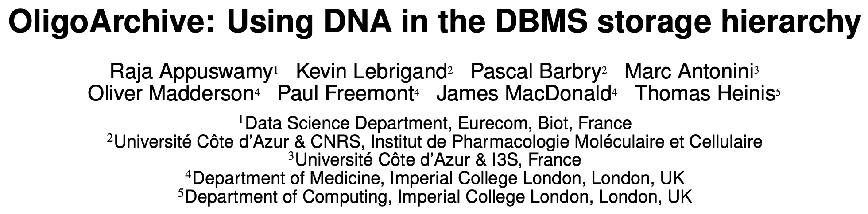

Slide 33
Background

Slide 34
Limitations of DNA Synthesis/Sequencing
Data layout and random access
  Max oligo length: ranges from a few hundred to a few thousand nucleotides at best.
  No logical addressing like block-based disk and tape. Address should be encoded along
Synthesis & sequencing errors
  Synthesis: longer oligo more errors and truncated by products
  Sequencing: short-read -> more substitution errors; long-read inserts or deletes spurious nucleotides.
  Error correction code is necessary

Slide 35
Limitations of DNA Synthesis/Sequencing
Structural complexity
  Patterns amplifying both synthesis and sequencing errors
    homopolymer repeats (multiple consecutive occurrence of the same nucleotide)
    high GC content (higher Gs and Cs than As and Ts)
  Low-complexity regions -> more error in sequencing
    same sequence of simple amino acids at similar positions.
  Encoder should avoid such problematic oligonucleotide sequences

Slide 36
Design

Slide 37
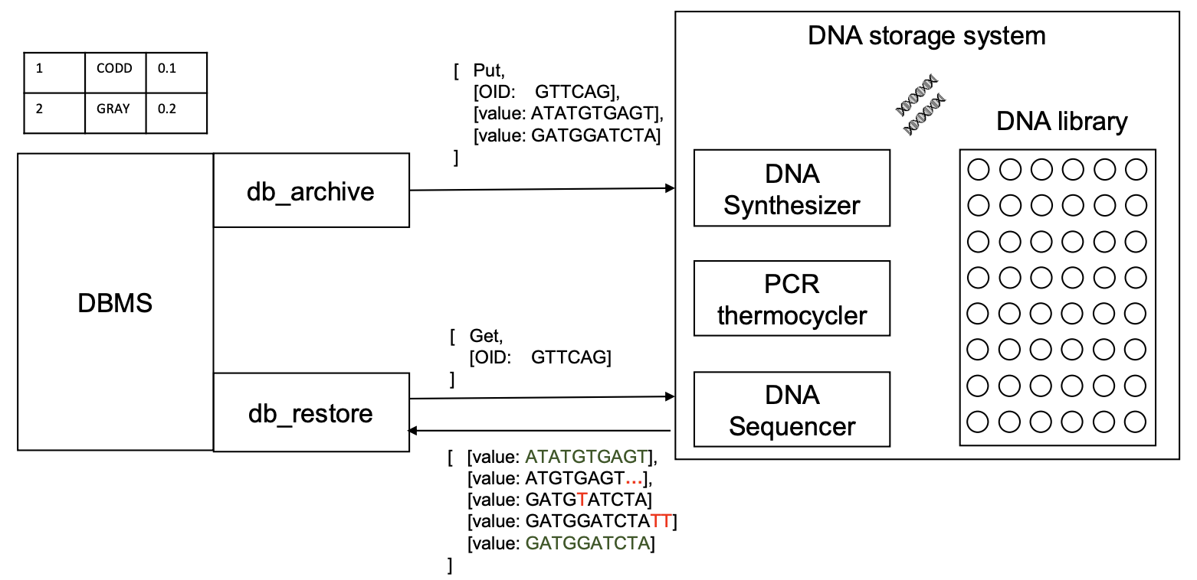
Overview
Encoding/Decoding
Synthesizing/Sequencing

Slide 38
Design
DNA Data Storage
Query Processing
Encoding Data
Decoding Data
Selection/Projection
Join

Slide 39
DNA Storage -- Encoding
Extraction and preprocessing
  dictionary encoding: convert variable length string fields into fixed length integers
DNA data representation
  Integers stream -> ternary digit (Huffman code, base3) -> Nucleotide (rotation code)
Schema-aware encoding
  primary keys -> primer. short records -> pack into one oligo. long records, breaking by attributes and store in multiple oligos.
Error correction metadata
  Detect: parity nucleotide; Correction: duplicating and reverse complementing oligo

Slide 40
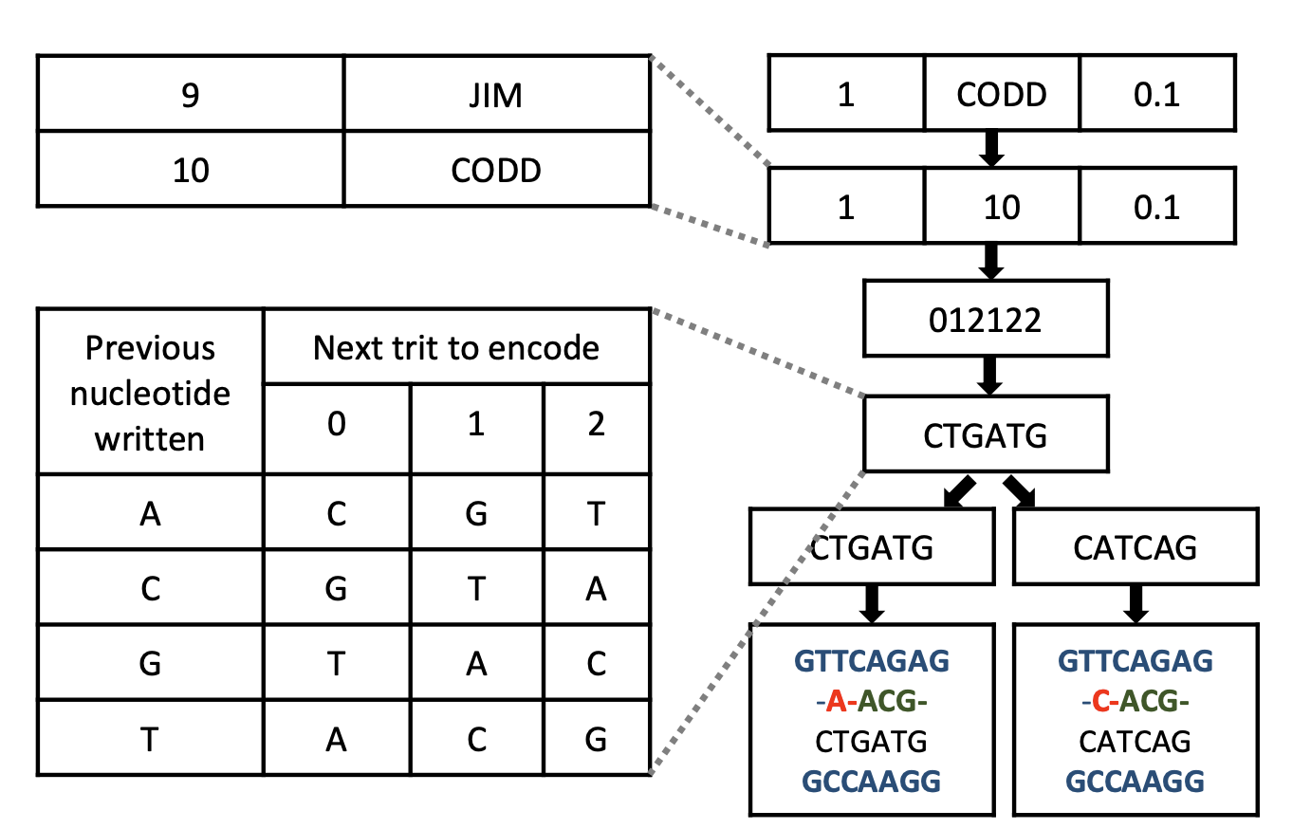
DNA Storage – Encoding (Cont’d)

Slide 41
DNA Storage -- Decoding
Merging the forward and reverse reads
  perform valid check to remove invalid oligos
Translate back to data
  Nucleotides -> trinary digit (base 3) -> data
Restore the records using the data

Slide 42
Query Processing
DNA used for computation: excellent parallelism
  Hamiltonian path problem [1] or the strategic assignment problem [27]. See paper
  replicate logical gates using DNA polymerase [5]
  Neither provides new computational capacity, nor is particularly fast
  But, it can work on countless oligos in parallel
Usage in Query Processing
  PCR
  DNA assembly methods

Slide 43
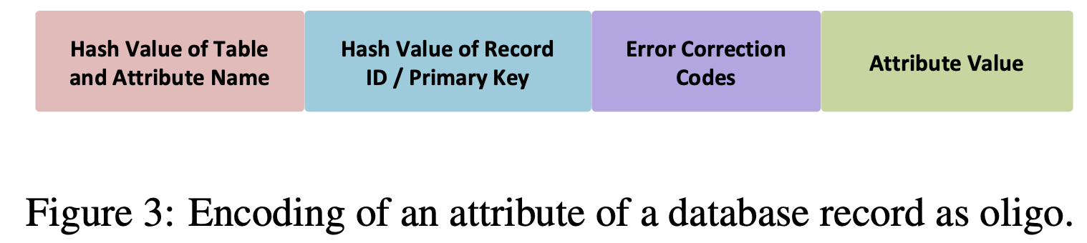
Query Processing -- Selection & Projection
Selection:
  Select target attribute (row)
  Primer: attribute we want to use,
Projection:
  refers to subset of the set of all columns found in a table, that you want returned.
  Only amplify attributes of our interest.
SELECT Orders.OrderID, Orders.CustomerName
FROM Orders
WHERE Orders.OrderDate=‘7/25/2019’;

Slide 44
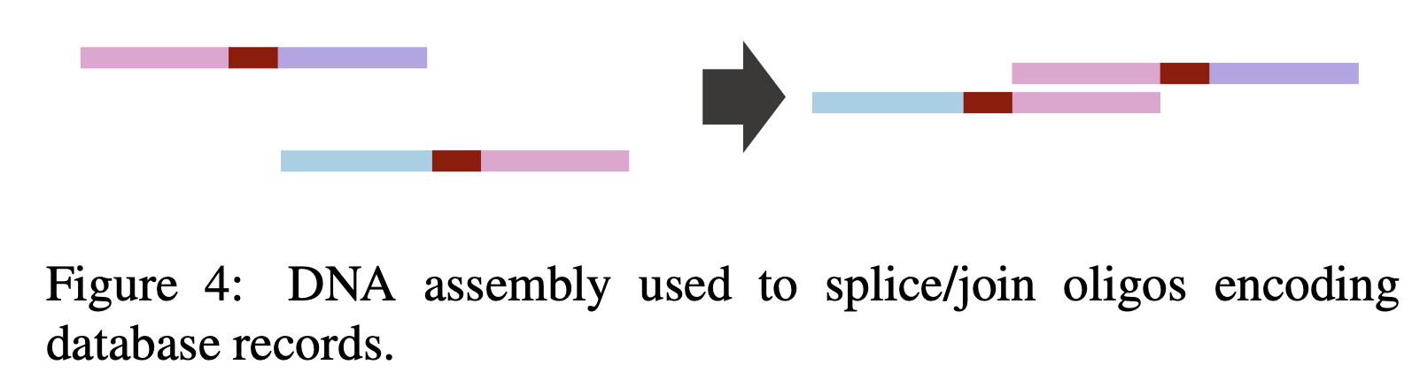
Query Processing -- Join
SELECT Orders.OrderID, Customers.CustomerName
FROM Orders
INNER JOIN Customers ON Orders.CustomerID=Customers.CustomerID
WHERE Orders.OrderID=12345;
CustomerID
OrderID
CustomerName
CustomerID

Slide 45
Evaluation

Slide 46
Setup
PostgreSQL v10.3
  pg_oligo_dump -> file
  pg_oligo_restore <- file
Sequencing: Illumina NextSeq 500 platform
TPC-H SF 10⁻⁴ dataset: 12KB, 44 records

Slide 47
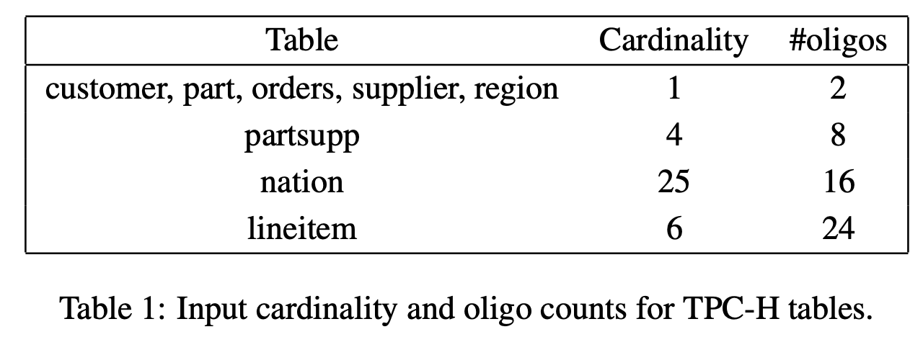
Encoding and Synthesis
Oligo length: 138 nucleotides
  91 for data, 5’ primer 26, 3’ primer 21
Result:
  1941 oligos total (103 ng): 346 oligos for dictionary, 150 oligos for 12KB of TPC-H data, and irrelevant oligos

Slide 48
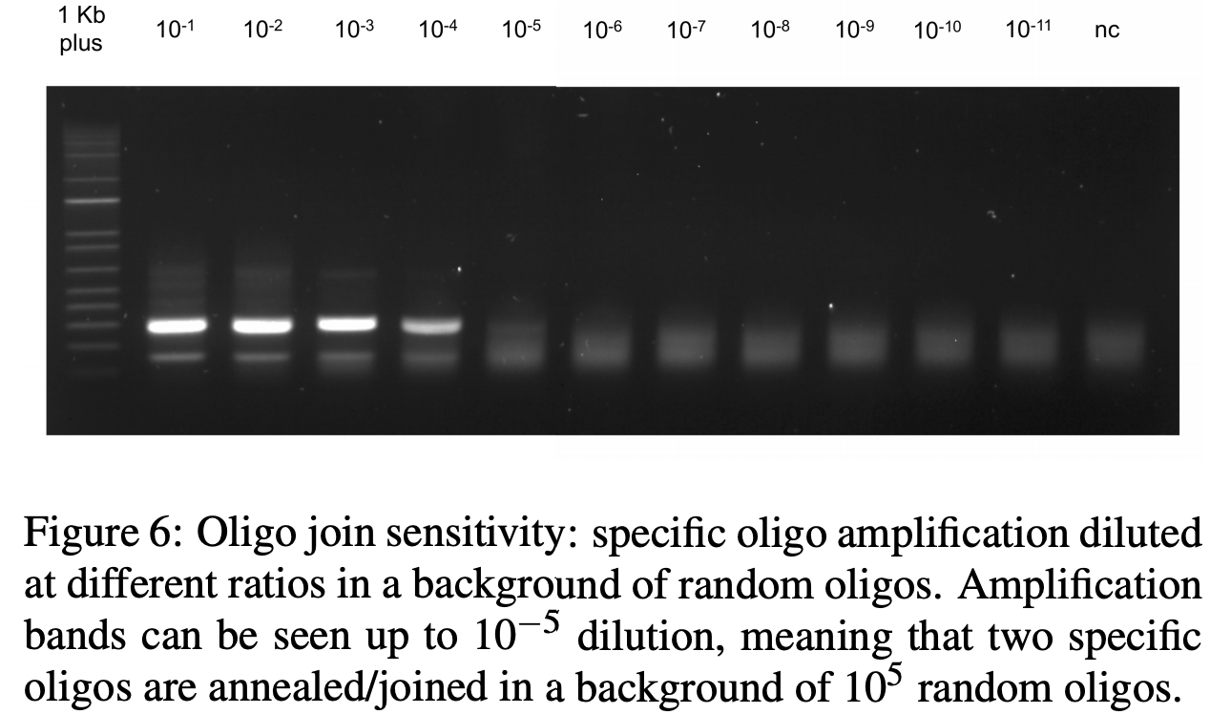
Query Processing
Selection: a single record is successfully selected.
Join: one pair of matching oligos joins in a background of 10⁵ irrelevant or non-matching oligos.

Slide 49
Summary
DNA is promising Storage Media: Density, durability
OligoArchive: an architecture for using DNA as the archival tier of a relational DBMS
  Data Archival: Dump and restore
  Data Query: selection, projection, join

Slide 50
Extensions
Not all SQL semantics are supported
  complex WHERE clause: non-equi selection
  complex join: non-equi-join
  multi-table join
File system semantic:
  how to efficiently support modification?
Scalability to large data sets
Parallelism
approximate string matching?
Selection and projection using one oligo?

Slide 51
References
DNA Synthesizing: https://www.youtube.com/watch?v=rD5uNAMbDaQ
PCR: https://www.youtube.com/watch?v=3XPAp6dgl14
DNA Sequencing: https://www.youtube.com/watch?v=ONGdehkB8jU
Gibson Assembly Cloning: https://www.youtube.com/watch?v=tlVbf5fXhp4

Slide 52
Puddle: A Dynamic, Error-Correcting,
Full-Stack Microfluidics Platform
ASPLOS’2019
Presented by Bingzhe Li
2020/01/14

Slide 53
Lighting Talk
https://www.youtube.com/watch?v=uwiINEcYXLQ&list=PL_T9xA0eFRMdxHuQwkhLoa5No-wTSx3Tc&index=14&t=0s

Slide 54
Motivation
Microfluidic device automates wetlab procedures by manipulating small chemical or biological samples.
Current designs:
  Inflexible
  Error-prone
  Prohibitively expensive
  Difficult to program

Slide 55
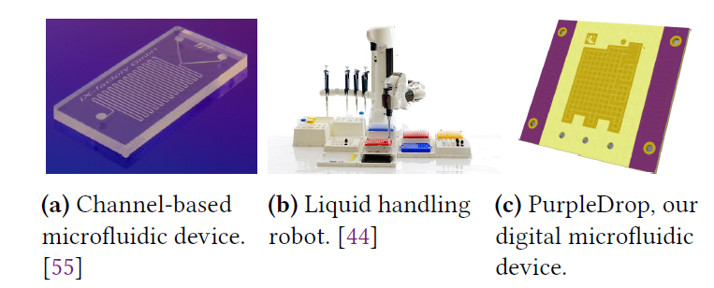
Microfluidic Hardware
Channel-based: offer high precision and low cost at scale.
Liquid handling robots: more general, aiming to emulate a lab technician with robotic arms controlling pipettes
DMF: flexibility at small size and potentially at low cost
  called electrowetting on dielectric: activating electrodes in certain patterns can move, mix, or split droplets anywhere on the chip
Notes:
Channel-based: offer high precision and low cost at scale. These devices move liquids through a fixed set of channels, so they are single-purpose by nature.
2. Liquid handling robots: more general, aiming to emulate a lab technician with robotic arms controlling pipettes
3. flexibility at small size and potentially at low cost
Activating electrodes in certain patterns can move, mix, or split droplets anywhere on the chip

Slide 56
Basic Controls in DMF devices
Turning individual electrodes on or off
To move a droplet from one location to another, a controller must activate the electrodes along that path in sequence
DAG (directed acyclic graph issue)/routine issue in VLSI

Slide 57
Dynamic Microfuidic Programming
Vision of this paper:
  a microfluidics platform that can combine computation and fluidic manipulation in an unrestricted, high-level programming model
  a runtime system that provides a high-level API for microfluidic manipulations.
APIs
Handling errors
Hardware implementation

Slide 58
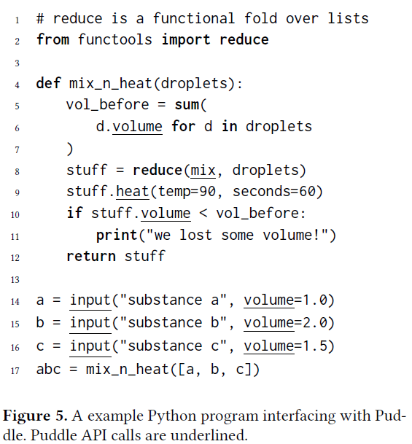
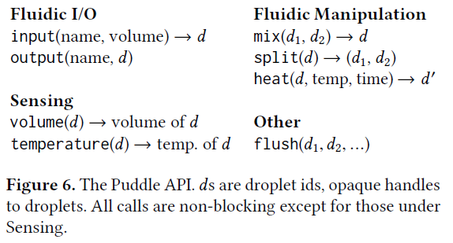
APIs
A example Python program interfacing
Complete Puddle API:

Slide 59

Error Handling
Two reasons cause API calls fail:
  Invalid arguments
  Using a consumed droplet id (not reuse droplets ids that have been consumed)
  Invalid arguments:

Slide 60
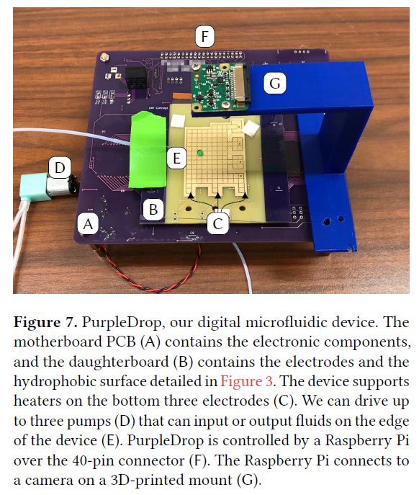
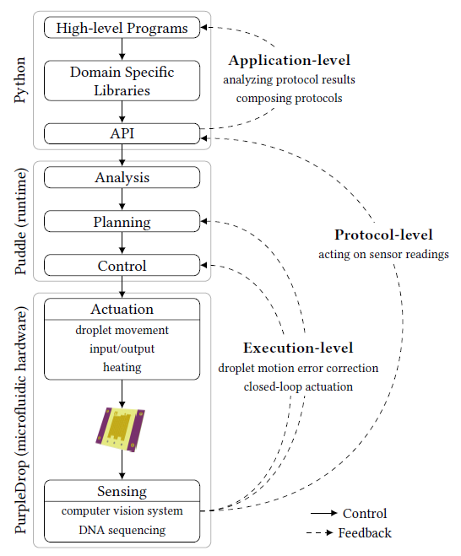
Implementation
Three levels of the stack

Slide 61
PurpleDrop DMF Device
PurpleDrop, all together, the components cost on the order of $300, orders of magnitude less than most other microfluidic systems.
DMF hardware:
mother board contains the electrical components such as high-voltage controllers, shift registers, etc.
daughterboard contains the electrodes that hold the droplets
The daughterboard is removable, allowing different configurations of electrodes with the same motherboard.
Electronic control: Raspberry Pi 3B
The Raspberry Pi runs Linux and sports a quad-core 1.2 GHz ARMv7 processor as well as GPIO pins
Peripherals: a heater, temperature sensor, and the ability to do both input and output of droplets. Input and output are driven by small peristaltic pumps which carry droplets to/from test tube reservoirs or other devices

Slide 62
Planning and Execution
The core of planning is placement and routing
Allocation constraints:
  A mix requests a rectangle slightly larger than the droplet to move and agitate droplets
  Place constraints (heater position)
Execution, Monitoring, and Rollback
  Execution: activating the electrodes
  Monitoring: computer vision system to check the states of droplets on the board
  A rollback consists of deleting the record and replanning all commands which have not been completed.

Slide 63
Evaluation
Error system
  Computer vision
  Error correction
PCR and Thermocycling
DNA sequencing

Slide 64
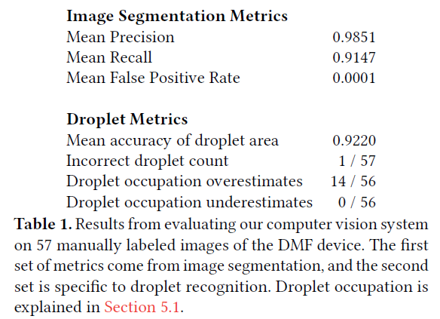
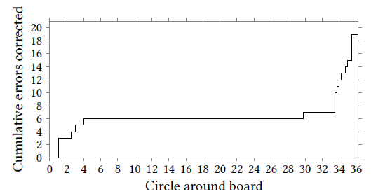
Computer vision accuracy
Error correction

Slide 65
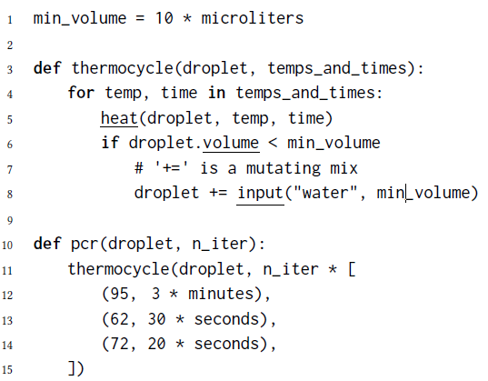
PCR and Thermocycling
Polymerase chain reaction (PCR) using thermocycle as subroutine amplifies DNA in a solution
We performed 8 cycles of PCR which required 2 replenishments to avoid evaporation. The procedure doubled the amount of DNA in our 10 microliter sample

Slide 66
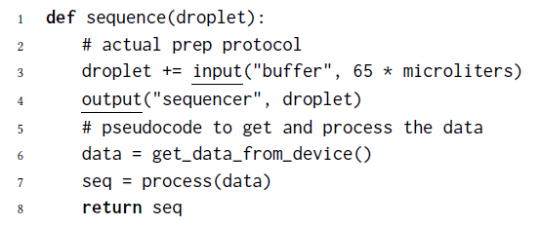
DNA Sequencing
Using Puddle and the MinION sequencer
To our knowledge, this is the first time that computation and protocol execution are merged in this way

