Slide 1
Software Defined Networking (SDN) & Software Defined Storage (SDS)
Karl Witthuhn
CSCI 5980
David Du

Slide 2
Overview
Traditional Network Design
Traditional Network Diagram
Software Defined Network (SDN) Design
SDN Network Diagrams
Why SDN?
Traditional NAS/SAN Design
Software Defined Storage Design
Why SDS?
SDN/SDS Products & Software
Conclusion

Slide 3
Traditional Networking Design
Control Plane and Data Plane exist on every device in the network
Control plane responsible for configuration and management of network such as routing protocols, access control lists (ACLs), remote management
Data plane responsible for forwarding, dropping, rate-limiting, filtering data packets to next destination
Each device has individual firmware, configurations, and capacity
Routing databases and full network connectivity can take time to propagate to all devices
Example – a link goes down 5 network hops away – a device will have to update a neighbor – which then updates the next neighbor and so on

Slide 4
Traditional Network Diagram
R1
R2
R3
O E2 10.0.1.0/24 [110/1] via 192.168.1.2, Fa0/0
O E2 172.16.1.0/30 [110/1] via 192.168.1.2, Fa0/0
C 192.168.1.0/30 is directly connected, Fa0/0
C 10.0.2.0/24 is directly connected, Fa0/1
O E2 10.0.1.0/24 [110/1] via 192.168.1.1, Fa0/0
O E2 10.0.2.0/24 [110/1] via 172.16.1.1, Fa0/1
C 192.168.1.0/30 is directly connected, Fa0/0
C 172.16.1.0/30 is directly connected, Fa0/1
O E2 10.0.2.0/24 [110/1] via 172.16.1.2, Fa0/0
O E2 192.168.1.0/30 [110/1] via 172.16.1.2, Fa0/0
C 172.16.1.0/30 is directly connected, Fa0/0
C 10.0.1.0/24 is directly connected, Fa0/1
Default OSPF Values
hello-timer: 10s
dead-timer: 40s
Fa0/0
192.168.1.1/30
Fa0/0
172.16.1.1/30
R1
R3
Fa0/1
10.0.2.1/24
Link State Update (LSA)
Fa0/1
10.0.1.1/24
Fa0/0
192.168.1.2/30
R2
Fa0/1
172.16.1.2/30
OSPF Hello #1 (10s)
OSPF Hello #2 (20s)
10.0.2.0/24
OSPF Hello #3 (30s)
10.0.1.0/24
OSPF Hello #4 (40s)
R3 Dead <R2 Update Table>

Slide 5
Software Defined Networking (SDN) Design
Most important item to remember – SDN centralizes the control plane into one place – an SDN controller
Data packets moving on the network defined as “Data Flows”
Networking hardware such as routers, switches, & firewalls can be generic and diverse
Hardware must support SDN module compatible with SDN controller
Controller communicates to hardware via a southbound API
Controller has a series of logical match tables called “Flow Tables”
Upper layer applications can define networking requirements to an SDN controller
SDN controller programs data planes to achieve requirements
Notes:
Controller uses TCP to update flow tables of networking devices to ensure reliable communication

Slide 6
SDN Design (Cont.)
Flow Tables
Classification are statements that define a match pattern against packets
Src/Dst IP, MAC, TCP/UDP port, Protocol, QoS classification, etc.
Action – how to process a matched packet
Basic Actions: Drop, Forward, Set
Newer actions: Push/Pop (Labels), Copy-in/out (TTL), Increment/Decrement
Default no match results in an explicit DROP action
Statistics on all actions are counted – this can be used for data evaluation, monitoring, or even adaptable decisions such as hot/cold ports
Flow Table 1
Match 1 | Forward
Match 2 | Forward
Match 3 | Drop
Match 1
Match 2
Data IN
Flow Table 0
Match 1 | Go to Flow table 1
Match 2 | Go to Flow table 2
Match 3 | Drop
Forward
Flow Table 2
Match 1 | Forward
Match 2 | Forward
Match 3 | Drop

Slide 7
SDN Network Diagram
Out-of-Band Network
SDN Controller
Public
Src: 1.1.1.1
Dst: 10.0.1.1
Ingress Policy
1 DST: 10.0.1.0/24 Action: Permit
2 DST: 10.0.2.0/24 Action: Drop
3 Default Action: Drop
1 MATCH -> PERMIT
1 MATCH -> PERMIT
1 MATCH -> PERMIT
R1
R3
R2
10.0.2.0/24
10.0.1.0/24

Slide 8
SDN Network Diagram
Out-of-Band Network
SDN Controller
Public
Src: 1.1.1.1
Dst: 10.0.2.1
Ingress Policy
1 DST: 10.0.1.0/24 Action: Permit
2 DST: 10.0.2.0/24 Action: Drop
3 Default Action: Drop
2 MATCH -> DROP
R1
R3
R2
10.0.2.0/24
10.0.1.0/24

Slide 9
Why SDN?
Traditional design does not scale
Maintenance of multitude of devices, configurations, and firmware becomes untenable
Myriad options for vendors, each with multiple networking operating systems, CLI, & GUI
Once developed, SDN can provide single window into security, configuration, and packet actions
Easier to add or remove capacity on the fly
Possible to add more routers or switches without taking down network for maintenance windows
Rules can be instantly applied to new equipment as soon as it can communicate to the SDN controller

Slide 10
Traditional NAS/SAN Storage Design
Vendor specific applications and software
Designing a custom storage solution can be extremely expensive
Solutions are created to meet a specific need or requirement
For example, a company might need 100 TB of NFS-mountable storage
This approach might be difficult to adapt to a future storage need
Devices/Applications might have different operating systems, configurations, firmware revisions, etc.
Occasionally protocol conversion required – such as Infiniband over IP (IPoIB) to take data from one area and write to a storage application
Overhead can cause performance loss
Difficult to troubleshoot specific use-cases with low adoption
Notes:
Vendor Lock-in can make it difficult to migrate data to other products due to interoperability
Training employees on a CLI or GUI

Slide 11
Software Defined Storage (SDS) Design
Main point like networking is SDS abstracts the software layer from the physical hardware
Spawned from the trend of hyperconverged infrastructure (software-defined….<insert technology here>)
Like SDN, uses an SDS controller to handle generic storage functions
Uses standard API across all hardware to accomplish storage functions such as write, read, etc.
SDS still requires an intentional task to architect solutions around storage capabilities (IOPS, Lifespan, Capacity, etc.)
Monitoring is still a challenge – catching errors and hardware degradation needs to be considered, even though redundancy is built into SDS

Slide 12
Why SDS?
Adding new types of storage devices is easy
abstraction of write/read operations allows for mixture of functionalities within a single storage solution
Scalability is functionally limitless
No SAN/NAS appliance specific limits on number of devices to manage
No vendor CLI/GUI lock-in
Hardware can be sourced from a variety of diverse manufacturers
Like SDN, add/remote storage devices without downtime
Adapt to unknown and future workloads without having to create a new storage implementation
SDS can easily adapt to high write/low read or low write/high read workloads without changing underlying hardware

Slide 13
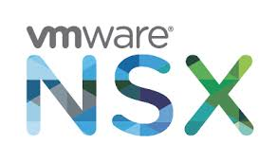
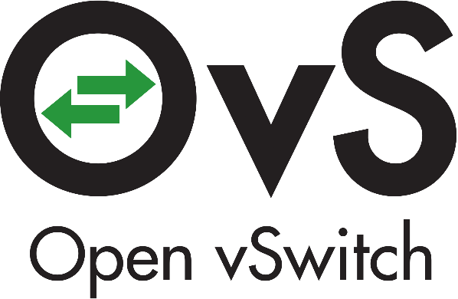
SDN Protocols and Software
Open-Source
OpenDaylight (ODL)
Project Floodlight (based on Java)
NOX/POX
Open vSwitch
Vendor/Commercial
Juniper Contrail
Cisco ACI
NXP VortiQA
VMWare NSX

Slide 14
SDS Protocols and Software
CephFS
Object store running on top of native file systems
GlusterFS
Distributed File store generally supporting overlay file systems
Other SDS Concepts and Products Exist
MooseFS
HDFS
DRDB

Slide 15
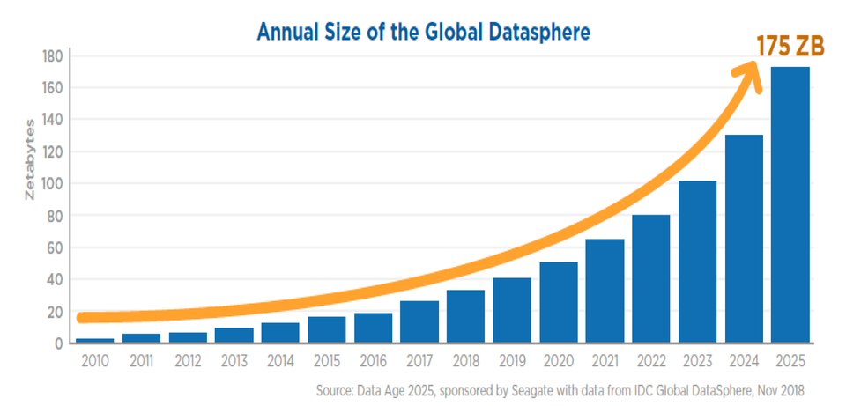
Challenges & Conclusion
Early adoptions of SDN protocols had scenarios where control plane was showing correct flow tables, yet measurement of data plane forwarding did not match
Slow switch CPUs, time to update switch ASICs, packet loss all contributing factors to issue
SDS/SDN solutions can be challenging to migrate existing storage/networking over to new implementation
Staff education, unsupported legacy hardware, under performing hardware
Most companies are investing lots of resources into simplifying an ever-growing demand for storage and networking requirements
By 2025, IDC says worldwide data will grow 61% to 175 zettabytes, with as much of the data residing in the cloud as in data centers. [6]
That’s 175,000,000,000,000 Gigabytes!

Slide 16
Sources
[1] Ceph vs GlusterFS vs MooseFS vs HDFS vs DRBD
https://computingforgeeks.com/ceph-vs-glusterfs-vs-moosefs-vs-hdfs-vs-drbd/
[2] SDN Versus Traditional Networking Explained
https://www.ibm.com/services/network/sdn-versus-traditional-networking
[3] What are the Differences Between Software-Defined Storage and Traditional SAN & NAS?
https://zadara.com/blog/2016/04/06/differences-software-defined-storage-traditional-san-nas-cloud-storage-2/
[4] What You Need to Know About SDN Flow Tables
https://people.kth.se/~dejanko/documents/publications/switches-pam15.pdf
[5] OpenFlow Instructions & Actions
http://flowgrammable.org/sdn/openflow/actions/#tab_ofp_1_4

Slide 17
Sources (Cont.)
[6] IDC: Expect 175 zettabytes of data worldwide by 2025
https://www.networkworld.com/article/3325397/idc-expect-175-zettabytes-of-data-worldwide-by-2025.html

Slide 18
Thank You!

