Slide 1
Thrift (RPC) Tutorial
Presented By: Kwangsung Oh

Slide 2
What is RPC?
Model for constructing distributed client-server applications
Analogues to a function call
Called procedure need not exist in same address space
Avoids networking details
Sun RPC, RMI, XmlRPC, JsonRPC, Thrift

Slide 3
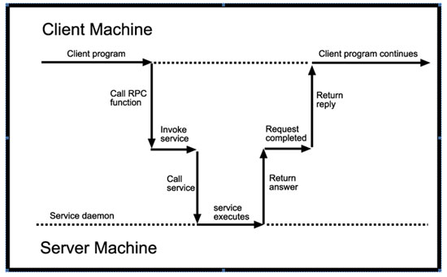
How RPC works
Notes:
The client makes a procedure call that sends a request to the server and waits.
When the request arrives, the server calls a dispatch routine that performs the requested service, and sends the reply to the client. After the RPC call is completed, the client program continues

Slide 4
RPC Application Development
Steps
  Specify interfaces for client-server communication in IDL (Interface Definition Language)
  Generate stub codes from IDL
  Implement interfaces
  Develop Client & Server programs

Slide 5
Thrift
The Apache Thrift software framework, for scalable cross-language services development
  C++, Java, Python, PHP, Ruby, Erlang, Perl, Haskell, C# and more
Thrift has a code generation engine to automatically generate client and server codes in various languages.
Widely used e.g., Facebook, Evernote, Cassandra and more
Built in representation for basic types
  bool, byte, i16, i32, i64, double, string, binary
Also support complex data types
  structs, containers (list, set, map)
http://thrift.apache.org/static/files/thrift-20070401.pdf

Slide 6
Thrift IDL
The Thrift interface definition language (IDL) allows for the definition of Thrift Types.
IDL file will be processed by the Thrift code generator to produce code for the various target language to support the defined structs and services in the IDL.
Thrift code generator
  Input: Thrift Interface definition language(IDL) file (.thrift suffix file), Language (cpp, java, py …)
  Output: One or more source code based on languages

Slide 7
Thrift IDL File example
multiply.thrift
struct numbers {
1: i32 x=0,
2: i32 y,
}
service MulService {
bool ping(),
i32 multiply_1(1: numbers),
i32 multiply_2(1: int x, 2:int y),
}

Slide 8
thrift to produce codes
> thrift --gen java multifly.thrift
Outputs: in ./gen-java
  MulService.java – for client and server
  Numbers.java – struct code
> thrift --gen cpp multifly.thrift
Outputs: in ./gen-cpp
  MulService.cpp(h) – for client and server
  MulService_server.skeleton.cpp – skeleton codes for server.
  Test_types.cpp and test_constants.cpp – for number
Python, ruby, C# and more languages are available

Slide 9
Interface implementation
Interface xxxservice.Iface should be implemented.
public class MulHandler implements MulService.Iface
{
@Override
public boolean ping() throws Texception {return true;}
@Override
public int multiply_1(numbers values) throws Texception {
return values.x * values.y;
}
@Override
public int multiply_2(int x, int y) throws Texception {
return x * y;
}
}

Slide 10
Sample java Client program
//Create client connect.
TTransport transport = new TSocket("localhost", 9090);
TProtocol protocol = new TBinaryProtocol(new TFramedTransport(transport));
MulService.Client client = new MulService.Client(protocol);
//Try to connect
transport.open();
//What you need to do.
int ret = client.multiply(3, 5);
Ctrl + c & Ctrl + v

Slide 11
Sample java Server Program
//Create Thrift server socket
TServerTransport serverTransport = new TServerSocket(9090);
TTransportFactory factory = new TFramedTransport.Factory();
//Create service request handler
MulHandler handler = new MulHandler();
processor = new MulService.Processor(handler);
//Set server arguments
TServer.Args args = new TServer.Args(serverTransport); args.processor(processor); //Set handler
args.transportFactory(factory); //Set FramedTransport (for performance)
//Run server as a single thread
TServer server = new TSimpleServer(args);
server.serve();
To avoid frequent I/O access
TSimpleServer: Single thread server
TThreadedServer: Multi-threaded server
Ctrl + c & Ctrl + v

Slide 12
Compiling generated files
Thrift libraries are not available in VMs but only code generator available.
For java, jar files (libthrift-0.9.0.jar, slf4j-api-1.7.14.jar) are needed for building a client and a server.
  Compile
    javac -cp .:./jars/libthrift-0.9.0.jar:./jars/slf4j-api-1.7.14.jar ./src/csci5105/*.java -d .
  Run
    java -cp .:./jars/libthrift-0.9.0.jar:./jars/slf4j-api-1.7.14.jar csci5105.MulServer
For cpp, need to contact to install Thrift libraries.

Slide 13
Simple performance comparison

