Slide 1

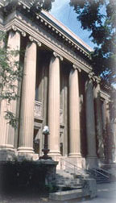
Emerging Infrastructure for Supporting Big Data and Cloud Computing
David Hung-Chang Du
Qwest Chair Professor
Computer Science and Engineering
University of Minnesota
du@cs.umn.edu
CRIS: NSF I/UCRC Center on Intelligent Storage

Slide 2
Research Basics
Technology Trend
Application Trend
Systems Trend
Understand the overall picture
Identify new issues with sound motivations
Formulate the problem and propose solutions
Verify or validate your findings

Slide 3
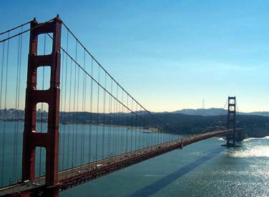
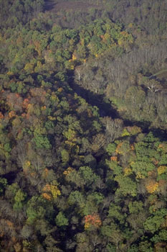
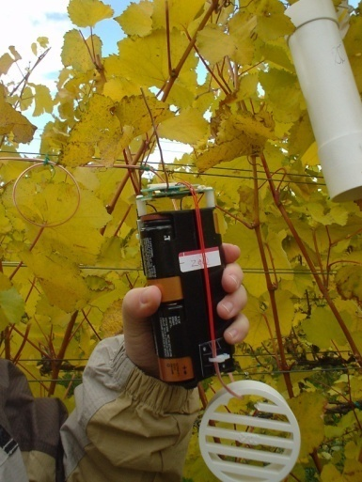
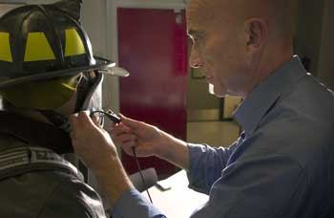
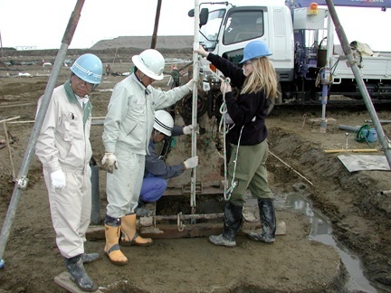
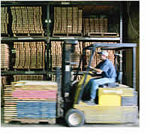
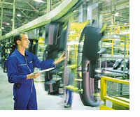

Instrument and Connect the World !
Bridge Monitoring
Building
  Environment
  Controls
Earthquake
  Monitoring
Elder Care
Factories
Fire Response
First Responders
Forest Management
Soil Monitoring
Supply Chain
Wind Response
… and more more

Slide 4
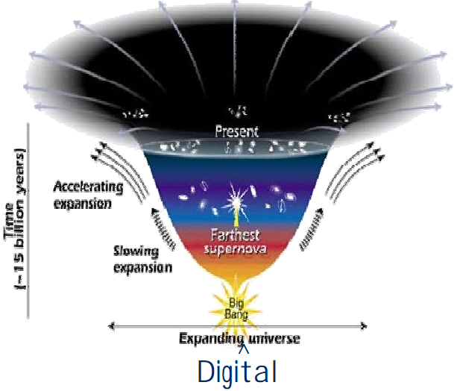
Digital Explosion: Data Centric
The digital universe will grow over six-fold, from 281 exabytes in 2007 to 1,773 exabytes in 2011
> 90% of the information in the digital universe is unstructured and absolute # of files growing faster than the TBs
----from IDC Survey presented in ISW 2008

Slide 5
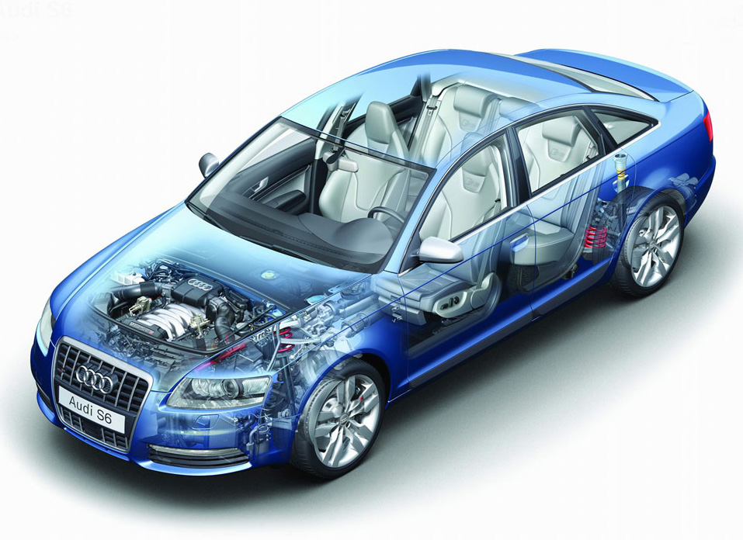
We Are Collecting All Kinds of Information
Indoor/outdoor temperature sensors
Passenger Occupancy
Fuel level
Seat belt tension
Oil sensor
Rain sensor
Water coolant temperature
Oxygen sensor
Accelerometer
Parking sensor
Speedometer
Odometer
Tachometer
GPS
Tire pressure monitor
Radar sensor
Anti thief sensors
Wheel speed

Slide 6
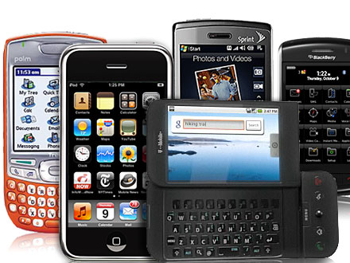
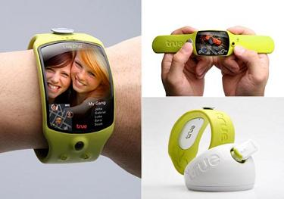
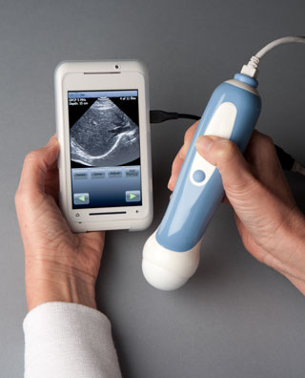




Rapid Evolution of Mobile Devices and Applications (More Data)
Notes:
At the same time, we have seen a rapid evolution of mobile devices and applications. Mobile devices have transformed from limited embedded systems to highly capable general purpose computing devices, such as smart phones, running on mobile platform such as Apple’s OS X, Google’s Android, and Microsoft’s Windows Mobile.
Everyday, there are mobile apps being introduced - We perhaps have already get used to use weather channel mobile apps, google maps to check real time traffic condition, read CNN the 5 things to know to start your day… Trip advisor, Yelp to find a restraurant, Fandango to find a movie to watch…

Slide 7

More Examples
1. Surveillance video data collected by Air Force drones
  One year’s collection requires 24 years’ processing (NYT, January 10, 2010)
2. Analog TV broadcasting becomes digital
3. Surveillance video cameras are widely deployed

Slide 8
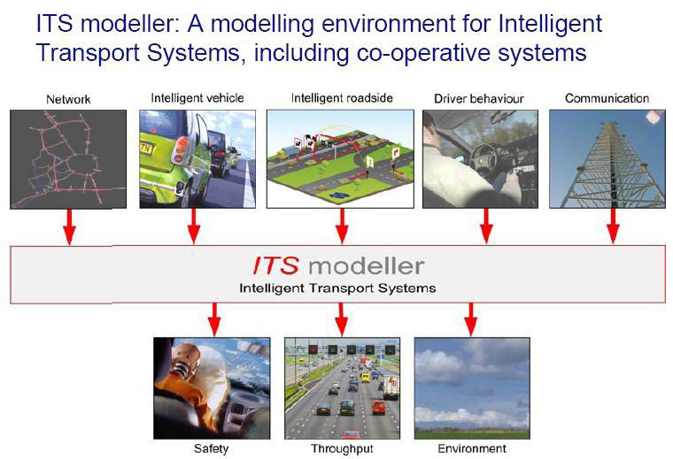
Research Methodologies Are Rapidly Changing

Slide 9
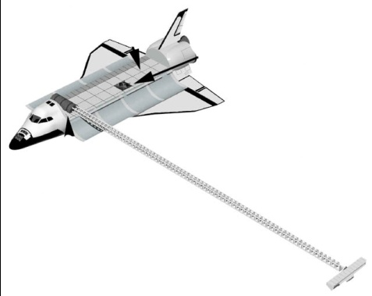
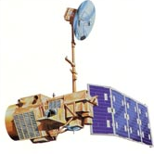
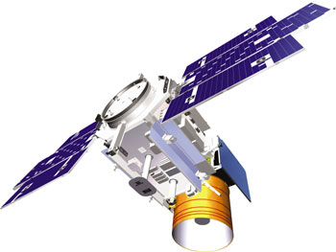
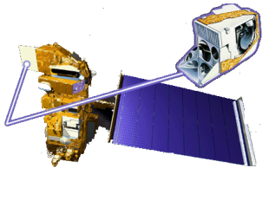
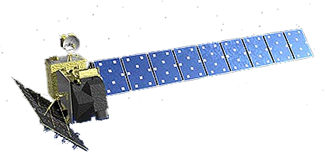
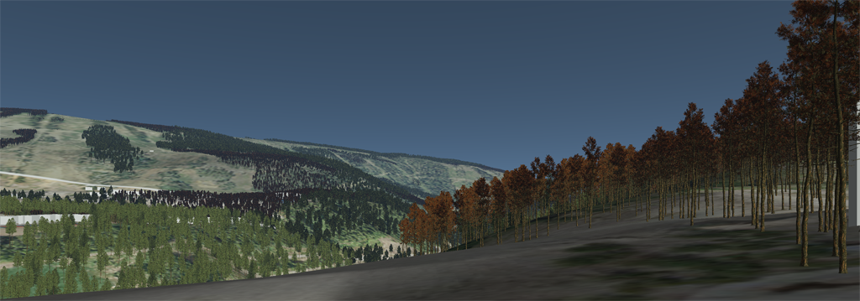
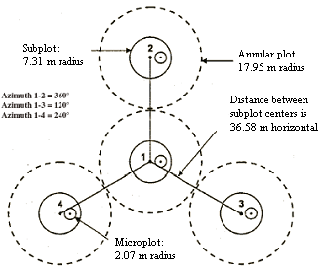

NASA Satellite and In Situ Observations
LANDSAT
ICESat
SRTM
MODIS
ALOS PALSAR
USDA FS, FIA Data

Slide 10
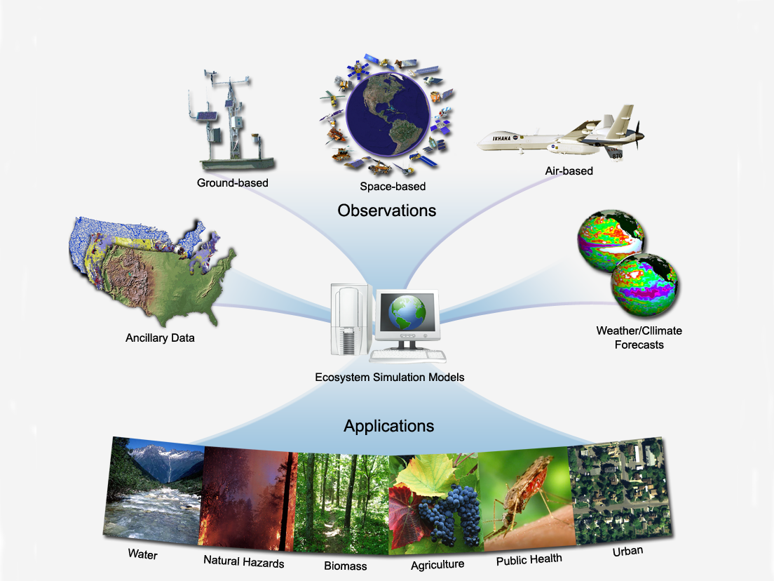
Ecological Forecasting predicting the effects of changes in physical, chemical, and biological environment on ecosystem state and function
Terrestrial Observation and prediction system (TOPS)
A data - modeling system for integrating satellite, surface data with simulation models
to produce ecological nowcasts and forecasts
Key elements:
Collect & Extract Data
Monitoring
Modeling
Forecasting
Local to Global
Focus on biogeo-
chemical cycles
Nemani et al., 2009, RSE

Slide 11
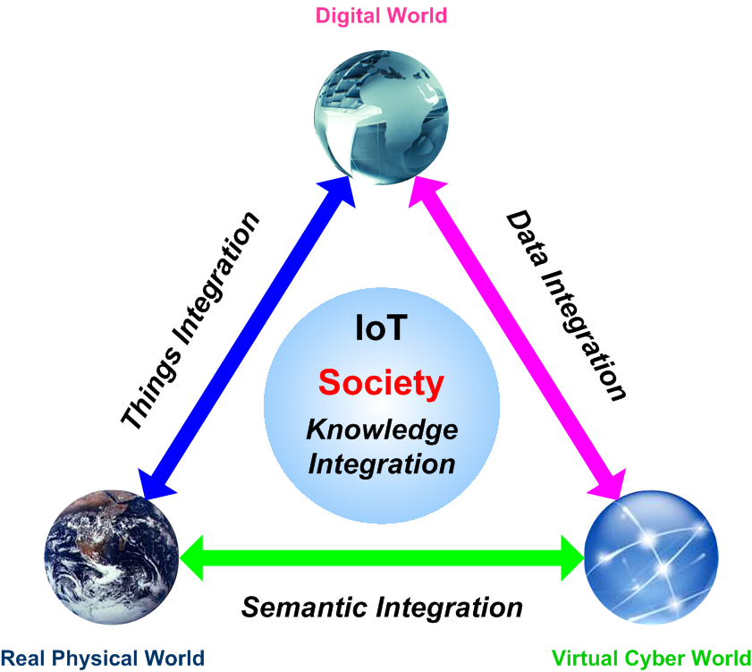

Slide 12
Information Based Medicine will require unprecedented access to diverse, integrated information
Challenges
Volume and complexity of data
Integrating massive volumes of disparate data
Need for sophisticated analytics
Growing collaboration across ecosystem

Slide 13







IBM Healthcare and Life Sciences Clinical Genomics Solution Conceptual Architecture
Medical Research
Clinical Care
Data Mining/Statistical Analysis/Visualization
Expression, SNPs, Clinical Studies & Trials, Proteomic
HIS, RIS, CIS, Pathology, Rx, Patient Charts
Adherence to Standards
HL7, BSML/HapMap, CDISC/ODM, MAGE-ML, CDA, etc.
WebSphere
Medical Information Gateway
Deidentification of Patient Data & Anonymous Global Patient Identifier Assigned
DB2 Information Integrator
Medical Information Repository
Medical Information Broker
Source scientific data & unstructured text files
e.g. MS Access. MS Excel, EST/ GenBank, XML, Medline, dbSNP

Slide 14
Challenges in the New Environment
Network is no longer just end-to-end
Data is no longer just structured
Drowning in Data; Loss in Internet
A New Internet Architecture Is Required
Data -> Information -> Knowledge
Data/Network Security
Data/Information Privacy
Long-Term Data Preservation
Scalability (Internet, cloud storage and exascale computing)

Slide 15
More Challenges
How to model dynamically changed data relationship?
  Relationship can be changed by an event
  Relationship can be changed by situations
  Relationship can be changed by interests
How to make network to be situational-aware?
How to integrate data delivery with dynamically changed situations/interests/events?
How to decide data to be sent (to whom?), to be stored (for how long?) and to be dropped?

Slide 16
Why VIA –Hardware structure
CPU
CPU
Memory
Controller
Memory
PCI Bridge
PCI Bus
SCSI
Ethernet
FC
Disk
Disk
LAN
SAN
Disk

Slide 17
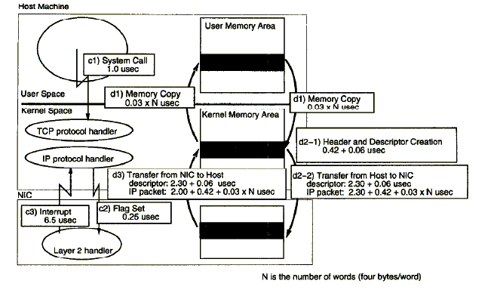
A Case for Data and Control Flow between Host and NIC

Slide 18
Intelligent Storage based on Object-based Storage Devices (OSD)
Exploited to store and retrieve data more efficiently with Indexing/Search capability
Knowledge
Captured in the attributes of an object
Information
[ INTELLIGENCE ]
Objects
← Extended attributes augmented view high level semantics associated.
Files
Blocks
← Traditional storage device view - raw bits, no associated semantics.

Slide 19

Intelligence on the Drives
Magnetic storage /Solid State Storage
Processor & DRAM
SAN/IP attachment
Execution environment
Semantic-aware
Application-aware
Object storage device
Search and indexing
Query and response
Applications
Services
DBMS
RPC, ...
File System
SAN driver
Disk driver
OS Kernel
Data+Data Semantic, Data Location Transparency, Storage Layer Reduction

Slide 20
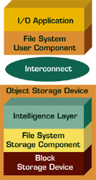
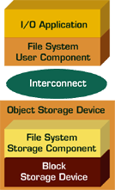
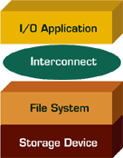
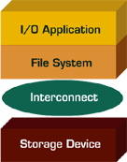
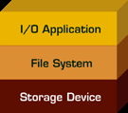
Evolution of Data Storage
Intelligent Storage Devices (ISD)
Object-based Storage Devices (OSD)
Network Attached Storage
SAN Attached Storage
Direct Attached Storage

Slide 21


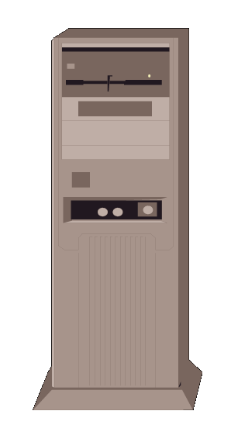
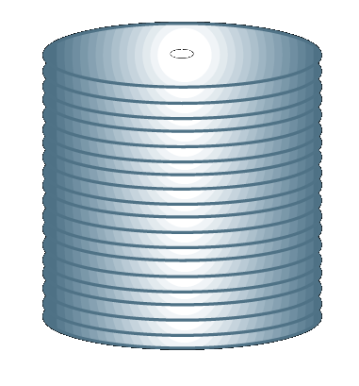

Overview of the OSD Architecture
Clients
Access Request
DATA
Network
Eth switch
SECRET
KEY
MANAGEMENT
Managers
Validate Capability
SECRET
KEY
SECRET
KEY
Object-based Storage Devices

Slide 22
OSD - Phase I Architecture
Local OS
Local File System
Security Agent
Application
Initiator
OSD Commands
iSCSI Initiator Driver
IP Network- SCSI Commands
Security
manager
MySQL
ACL
Data
iSCSI Target Driver
Local OS
OSD
Target
OSD Cmd Emulator
Policy
Manager
Local File System
Linux-based
Host
Disk

Slide 23
DISC OSD Reference Architecture
OSD Client
Meta Data Server
File System Clients
Meta Data Manger
OSD API / I/O Path
Security
OSD Initiator
Intel iSCSI Initiator / Driver
Linux TCP/IP Stack
OSD Target - Phase I
OSD Target – Phase II / III
Linux TCP/IP Stack
Intel iSCSI Target
T10 OSD Command Parser
Simple OSD
OSD File System /
Command Processor
Linux File System
Linux Disk Driver

Slide 24
Future Global File System Architecture

Slide 25
Our View of Intelligent Storage
Storage that:
  Is aware of the data objects that it stores
  Can interpret the attributes of the data objects
  Can independently manipulate the objects
  Can independently build a search and indexing mechanism based on the objects contents
  Can be (dynamically) taught new methods for understanding and manipulating objects, attributes and their content

Slide 26
Active Data Objects
Problem: How can the OSD environment be extended to be even more flexible?
Approach: Allow objects to include executable methods in addition to the data, attributes and metadata. These methods can be invoked when a pre-set condition is met.
Uniqueness: Data objects are truly autonomic. Intelligent storage devices have to designed to provide such a capability.

Slide 27
OSD Implementation
File Client
System Configuration
1 file client: Blade server node (linux)
2 or more OST: Blade node (linux)
1 MDS: Blade node (linux)
Integrates method API into Lustre file system
Develops new distributed grep program
Application (distributed grep)
OS bypass
file I/O
Method API
Run-time
Lustre client
filesystem
Meta-data
WB cache
OBD
Client
MDS
Client
Recovery
Lock
Client
Networking
Object Storage Target
Object Storage Target
Meta-Data Server
Networking
Networking
Networking
Methods
Run-time
Methods
Run-time
Load Balancing
Object-Based Disk
(OBD) server
Recovery
Recovery
Recovery
Lock
server
Object-Based Disk
(OBD) server
Lock
server
MDS
Server
Lock
Server
Lock
Client
Object-Based Disk (OBD)
Object-Based Disk (OBD)
MDS Backend

Slide 28
Semantic Gulf
Data is organized based on data characteristics
  Efficiency and scalability are primary
User intentions and context are not considered
  Query environment does not maintain the state of the user
Possible Solutions
Keywords, Ontology, Query by Example, Relevance Feedback, Event-based Indexing

Slide 29
Two-Level Search & Indexing
Meta Data Server
4
Content-based
query
SIE
5
GUID
3
Content-based
query
Meta Data Server
IP Network
Content-based
query
SIE
Response
1
6
SIE
Region
IP Network
SIE
SIE
2
Authenticate client
Meta Data Server
Client
3
IP Network
Content-based
query
Content-based
query
SIE
4
SIE
SIE
SIE
5’
5’
5’
Home Region
6’
Content-based
query
Response
IP Network
SIE
High-level Searching & Indexing Engine
SIE
Low-level Searching & Indexing Engine
SIE
SIE
SIE
Region

Slide 30
Extended Attributes (EAs) in Intelligent Storage
Motivations
  Attributes are important extension of objects to traditional files
  EAs can support semantic-aware and application-aware storage
  Preliminary solutions in existing file systems: Ext2, Ext3, XFS, JFS, ReiserFS, etc.
Objective
  How to use EAs and how to efficiently store and access EAs?
    Access control of EAs
    Fast retrieval of any EA by name
    Fast bulk copy of EAs
    Efficient space utilization for variable-sized EAs
    Help on search and indexing

Slide 31
Storing EA on Storage Media
Mode
ACLs
Owner info
ACLs
Size
Inline (within i-node) space for small EA
External pages for more EAs
Differentiate per-instance EAs (IEAs) and per-object EAs
  Example: When copying, “audit trace” EA should not be copied to the new object
Separated EA headers and EA values
  Headers are organized into index for fast lookup
  Headers have inline space for storage small values
  EA value pages support efficient variable-sized EA values
Timestamps
EA headers
……
ACL Block 1
ACL Block 2
EA values
EA Header Block
IEA headers
EA Value Block
reserved space for inline EA
IEA values
IEA Value Block
Data
IEA Value Block
Data
Direct Blocks
Data
Indirect Blocks
Data
Double Indirect Blocks
Data
Triple Indirect Blocks
Data

Slide 32
Facts in New Environment
Extremely large Scale Internet reaches every corner of the earth
Support massive mobility
Large number of smart embedded sensors are in our daily objects
Each sensor can compute, communicate and sense
They form the largest network ever and generate huge amount of data
Each sensor generates data continuously with two important dimensions: time and location coordinate
We are drowning in data and loss in Internet
A new Internet architecture and new ways to handle data are required

Slide 33
More Future Trends
Embedded processors with great processing power and big storage capacity will be deployed all over the places
Computers start to show intelligence over human in certain aspects (Considering Watson the computer becomes the winner of Jeopardy and AlphaGo defeats legendary Go player)
Huge amount of useful data are available and more are generated from every corner of the earth (Data Collection, Extraction, Transformation, and Analytic Are Require)

Slide 34
Storage Research Trends
New Storage Devices (Active Devices): Small & Big Capacity with Various Performance, Longer Lasting Duration, Better Support to Applications (Fewer Software Layers, but More Varieties of Storage Devices)
Emerging Storage Hierarchies (Multi-Tier): Cloud Storage (OpenStack Based?), Key-Value Stores, Tiered Storage (not really tiered), Extremely High Performance, More Integrated with File Systems/Applications, Software Defined Storage, Software Defined Data Center, Global Storage
New Applications (Analytics & Decision Making): Data Analytics, Archive vs. Backup

Slide 35
Challenges of Data Management and Data Analytics
Dealing with highly distributed data sources & types
Tracking data provenance, from data generation to data preparation
Validating data
Working with different data formats and structures
Ensuring data integrity, security, privacy and sharing
Developing methods for visualization massively data
Coping with real-time analysis and decision making

Slide 36
Solutions?
New Internet Infrastructure (fully integrating networking with storage: SDN+SDS?)
Intelligent Storage (object-based? Active devices? )
Store Data, Meta-Data, and Semantic Together (extended attributes? Adaptive key-value store? )
Merging HPC and Cloud in Data Centers (performance+capacity)
Global Storage and File Systems (Internet Scale?)

Slide 37
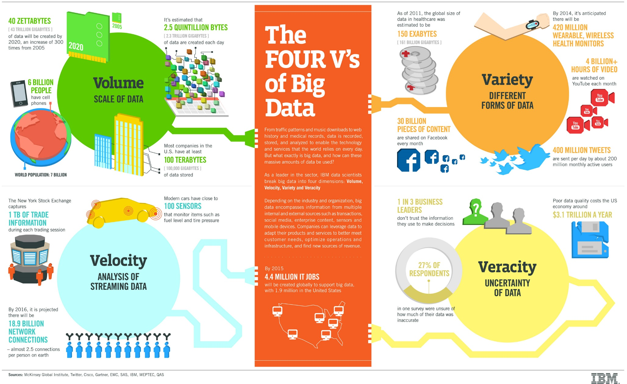
4 Vs of Big Data

Slide 38
Current Effort on Big Data
Flexible & Fast Processing: In Memory Processing
Multiple Data Sources: Data Steaming
Decision Making vs. Querying: Machine Learning Approach
Identifying Useful Information on Storage : active storage devices: exhaustive search?
Long-Term Data Storage: New Archive Architecture?

Slide 39
The Data Centric Future of IT
What will it look like?
HPC
Cloud
Cloud
Enterprise
Data Center Future

Slide 40


























The Changing Storage Landscape:
Services
Big Data
Software
Cloud
Systems
Software Defined Storage
Devices
Open Source
Components
Source: Seagate presentation

Slide 41

Expands I/O Stack to Fit Various Needs
1-2 PB/sec
Residence – hours
Overwritten – continuous
Host server based memory architectures- DRAM, 3D Xpoint
Memory
3PB DRAM
4-6 TB/sec
Residence – hours
Overwritten – hours
Host based PCIe cards moving to Shared NVME
Burst Buffer
6-8PB
Data Movement Management
1-2 TB/sec
Residence – days/weeks
Flushed – weeks
Parallel File System
80-100PB
PFS based systems with high performance SAS disk
100-300 GB/sec
Residence – months-year
Flushed – months-year
High Perofrmance Storage
300-500PB
Object based high capacity systems/disks (SATA) – Active Archive
10s GB/sec (parallel tape)
Residence – forever
Tape
New TAM Expansion Opportunity
Archive
10EB

Slide 42
New Memory/Storage Technologies

Slide 43
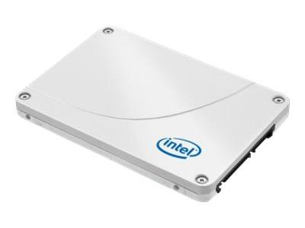
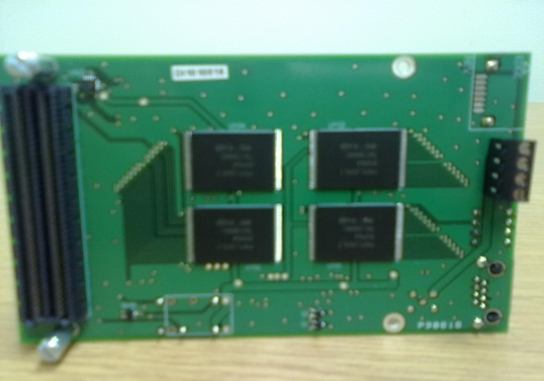
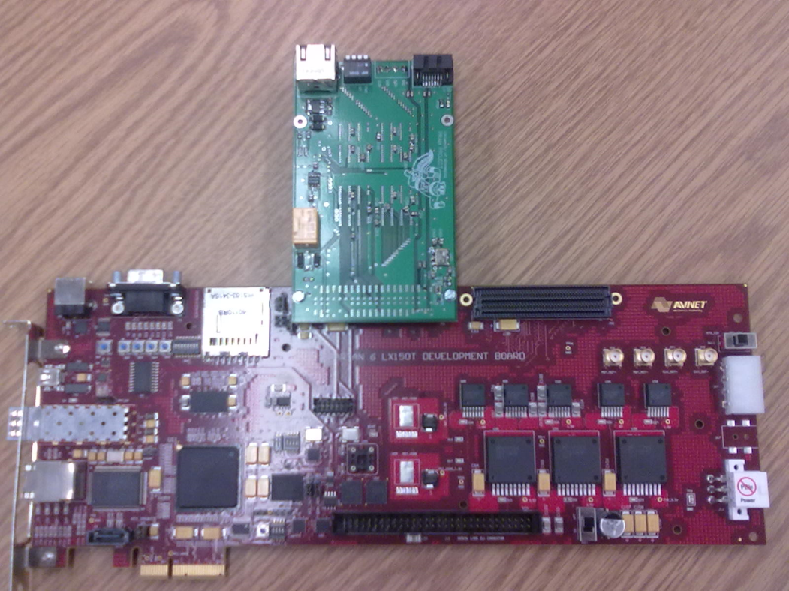
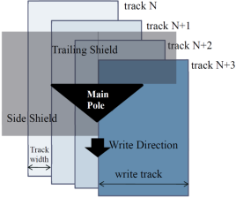
New Storage Technologies
Flash Memory based SSD
FTL Design
PCM Prototype
Shingled Write Disk
Design and Layout

Slide 44
Summary of Memory Technologies
 | HDD | DRAM DIMM | Flash SSD | PCM (25nm)
Density (μm²/bit) | 0.00006 | 0.00380 | 0.00210 | 0.00250
Read Latency (ns) | 3,000,000 | 55 | 25,000 | 48
Write Latency (ns) | 3,000,000 | 55 | 200,000 | 150
Read Energy (pJ/bit) | 2,500 | 12.5 | 250 | 2
Write Energy (pJ/bit) | 2,500 | 12.5 | 250 | 19.2
Static Power | Yes | Yes | No | No
Endurance | >10¹⁵ | >10¹⁵ | 10⁴ | 10⁸
Nonvolatility | Yes | No | Yes | Yes

Slide 45





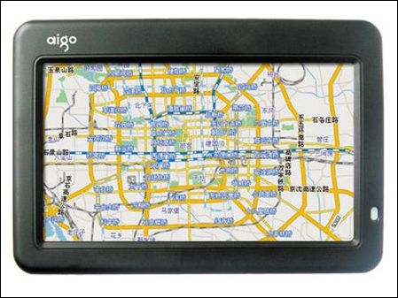
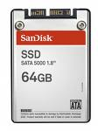
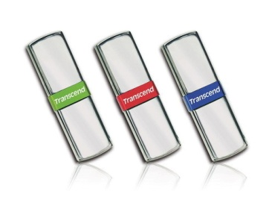
Why Flash Memory?
Diversified Application Domains
  Portable Storage Devices
  Consumer Electronics
  Industrial Applications
  Critical System Components
  Enterprise Storage Systems
Notes:
由於 flash memory 有 non-volatility, shock-resistance, 及 low-power consumption 的特性，因此越來越多領域採用 flash memory來儲存資料及程式碼。
其應用領域從消費性電子產品以至個人電腦、機器人及航太產業。
Small size, non-volatility, shock-resistance, low-power consumption, lost cost
Becuase System on a Chip and hybrid devices are becoming more and more popular,

Slide 46
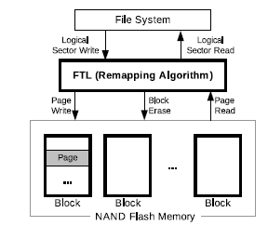
Flash-based SSD Characteristics
Random read is the same as sequential.
Read and write by the unit of pages
Does not allow overwrite. Need erase before writes. Erase is performed in blocks
Typical block size is 128 K and page size 2K
Write is slower than read. Erase is a very slow operation
Read takes 25 microseconds, write takes 200 microseconds, and erase takes 1500 microseconds
Limited number of writes per cell. 100 K for SLC and 10K for MLC.
Flash Translation Layer (FTL) sits in between file system and SSD. FTL provides remapping and wear-leveling
SSD

Slide 47
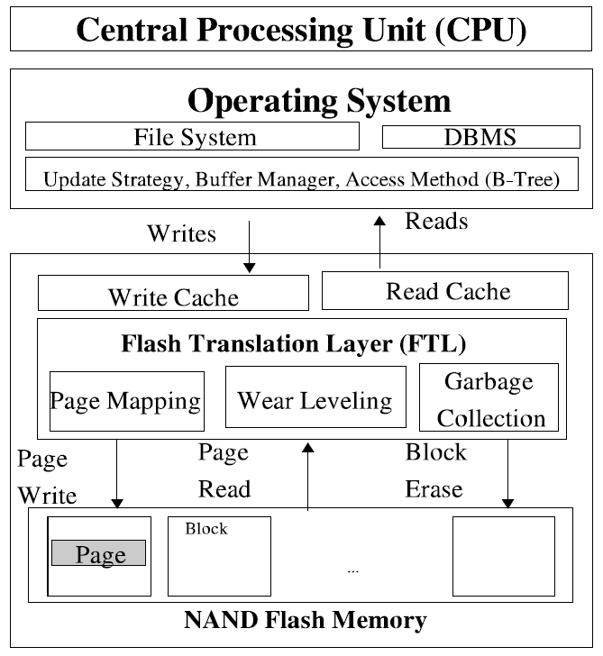
High-Level View of Flash Memory Design

Slide 48
Summary of SSD Research Results
Robust and Reliable Design of SSDs
Integrating SSDs into Storage Hierarchy
New FTL Design: A Convertible FTL Design
Efficient Wear-Leveling Algorithm
Optimal/Efficient Read/Write Caching
Hot and Cold Data Classification
Bloom Filter Design and Key-Value Store Based on Flash Memory
Using Sampling Technique for Meta-Data Management in FTL

Slide 49
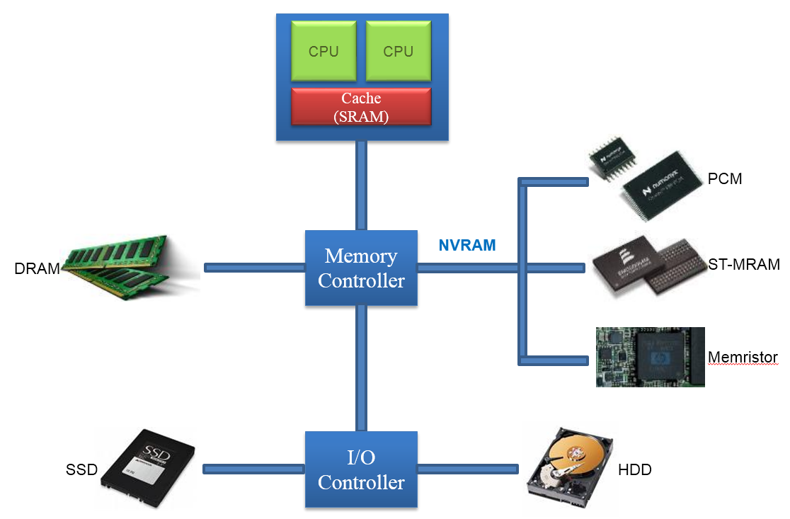
NVRAM Impacts
Incorporate NVRAM into current systems as the main memory or part of the main memory
Design or improve mechanisms to fully explore the advantages of NVRAM

Slide 50
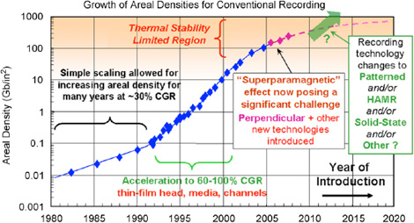
Motivation
Traditional HDDs possess their merits as they can provide large capacity with low cost.
Areal density limit → Shingled Magnetic Recording
Figure Source: http://www.popularmechanics.com/technology/engineering/news/434255

Slide 51
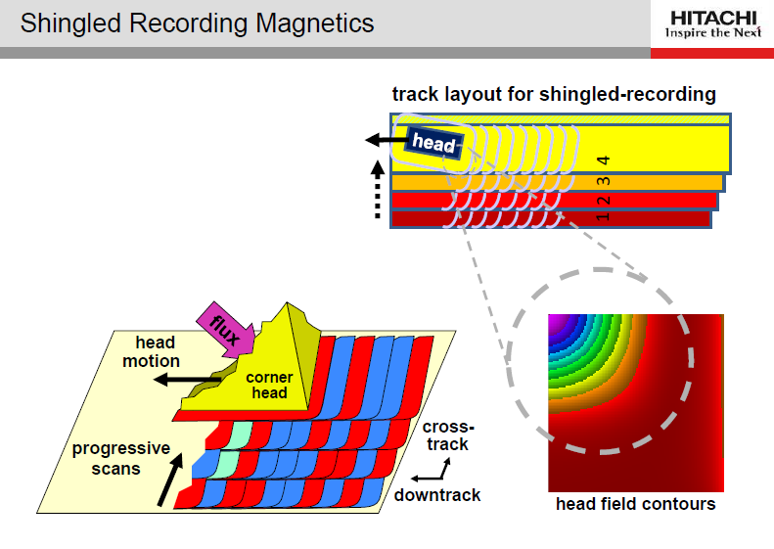

Slide 52
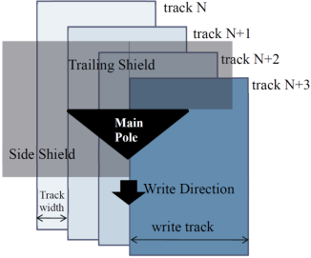
Shingled Magnetic Recording
Squeeze more tracks in the same area
  Higher Capacity
Write head is wider than track width
  Support Sequential write
  Random write/update interference
track n
track n+1
track n+2
track n+3
track
width
Shingling tracks
Figure Source: “Design Issues for Shingled Write Disk System”, In Proceedings of the 2010 IEEE 26th Symposium on Mass Storage Systems and Technologies (MSST), 2010.

Slide 53
Possible Methods
“In-place Update”: many small bands
  Protect previously-written data by Read-Modify-Write
  Behaves similar to regular disks
“Out-of-place Update”: few large band
  Maintain data in circular log structure
    Data Addition to head pointer
    Data removal from tail pointer
  LBA-to-PBA mapping is not fixed
  Transfer random writes into sequential write
  Compromise sequential read performance
Higher Space
overhead
Write
Amplification
Indirected
Addressing
Defragmentation
(Garbage Collection)
Notes:
We will investigate the method

Slide 54
Indirect Addressing & Defragmentation (Garbage Collection)
Similar to Solid State Drives (SSDs)
  Keep track of valid data location
  Out-dated data is invalidated
  Invalid data must be cleaned when necessary
  Valid data might be migrated during defragmentation (Garbage collection)
Different from SSDs
  In SWD, defragmentation requires no explicit action for invalid data erase.

Slide 55
New Memory/Storage Hierarchy
PCM as main memory
PCM as secondary storage
I/O Bus
I/O Bus
Processor
Processor
Virtual memory
File system
Virtual memory
File system
DRAM
PCM
FLASH
Disk
DRAM
PCM
FLASH
Disk
PCM as secondary storage provides:
Low access latency
PCM as main memory provides:
High capacity
standby power

Slide 56
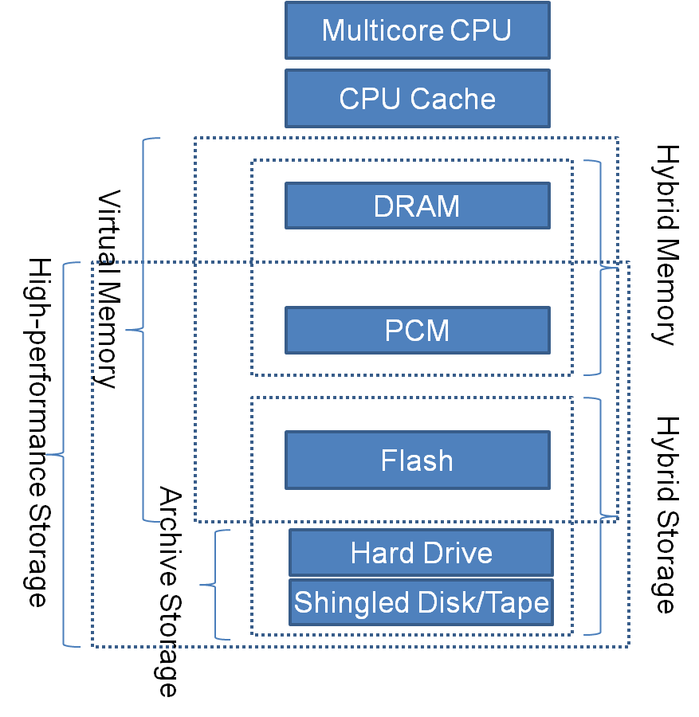
New Memory and Storage Hierarchies
Data Storage
Data Migration
Multi-Level Caching
Data Prefetching
Tiered Storage

Slide 57
Storage Layer Management and Caching
Read Queues (RT)
Read Queues (Prefetch)
Write Queues (Offloading)
When/ Where/how much
SSD
Big Memory with PCM
SATA Disks
off
off
On
Cloud Storage

Slide 58
Cloud Storage and
Big Data
OpenStack
VM vs. Container
Durability, Reliability and Availability
Private vs. Public Cloud

Slide 59
Project: Storage Systems Prototype with I/O Hints
Hints generation
QoS-aware IO calls
File System
QoS to hints
SCSI Device Driver
I/O Requests
SCSI Hints
Generic Block Layer
BuildingHints Mapping Table
Persistent Data Structures
Data Blocks Classifier
Logical Volume
bio
Cache Buffer
Cloud Objects Prefetch
DM Table
Hints Mapping Table
Device Mapper
Logical Volume vol1
Linear devices
SSD
HDD
Cloud
Thin Client

Slide 60
Parallel File Systems and IO Workload Characterization

Slide 61
Why Is This Important?
Workload Characterization
  Key to performance analysis of storage subsystems.
  Key to the implementation of simulators, as captured/synthesized workloads are key inputs.
Key Issues
  Lack of widely available tool sets to capture file system level workloads for parallel file systems
  Lack of methods to characterize parallel workloads (for parallel file systems)
  Lack of methods to synthesize workloads accurately at all levels (Block, File , etc)
  Understanding of how existing workloads scale in the exascale regime is lacking

Slide 62
Goals and Objectives
A detailed understanding and survey of existing methods in file system tracing, trace replaying, visualization, synthetic workload generators at the file system input levels, and existing mathematical models
Tools , techniques and methods to analyze parallel file system input traces (require to know more about OS, meta-data server, and applications)
Models to characterize the above workloads traces (Using statistical and analytical methods)
Synthetic workload generation at the parallel file system input level – which will be used as inputs to the simulator.
Understanding of the interactions of workloads at the file system level and making the file system aware of the workloads

Slide 63
Block-Level Workload Characterization
  Storage system performance cannot be determined by the system alone.
P=f(S, W)
Improving system for all possible workload space is difficult.
If we know the real workload space we can improve performance more efficiently.
P | System Performance
S | Storage System
W | IO Workload
Possible Workload Space
Real Workload Space

Slide 64
Framework of I/O Workload Characterization
Original trace
Comparison 2
Replayed trace
Arrival pattern, File/Data access pattern in the form of parameters
Workload characterization
Replay on same/different storage system
Workload
Parameters
Comparison 1
Replay by workload replayer
Changes to applications and /or system ( either host or storage)
Parameter adjustment
Comparison 3
Adjusted
Parameters
Workload generation
Synthetic trace
Action
Output

Slide 65
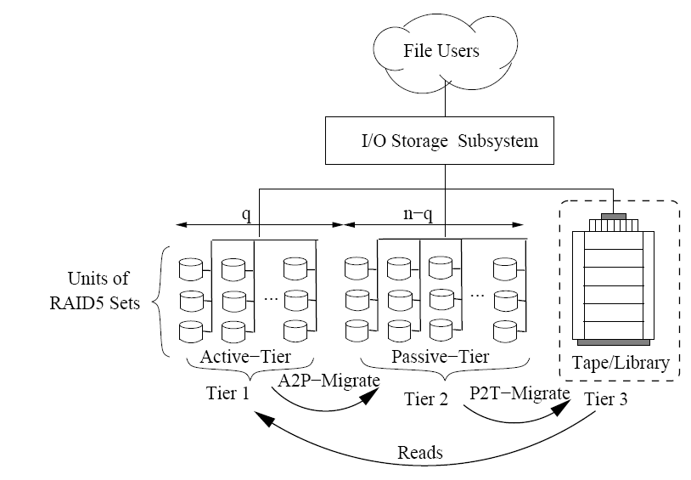
Tiered Storage Research

Slide 66
Data Migration, Duplication, and Deduplication
Tiered Storage Management
When a file is accessed, we may want to move related data level up to a faster storage provisioning potential near future access requests
Duplication level optimal for a long-term storage
Dedup algorithm and how to preserve it long-term (need to make sure we know how to get the data back)
How to find the right balance between duplication and dedup? How do we validate that data is stored the we think it is?
Imperfect dedup may be what we are looking for. However, what do we do if we want to have different levels of backup for different data.

Slide 67
Power Management and Adaptation

Slide 68
Power Breakdown
Data Center Power Consumption
  50% HVAC
  20-35% Servers
  10-25% Storage
  5% Networking
Different Types of data centers
  Compute Centric (Ex: HPC)
    35% Servers,10% Storage, 5% Networking
  Data Centric (Ex: Enterprise)
    20% Servers, 25% Storage, 5% Networking
  Average Case
    25% Servers, 20% Storage, 5% Networking
68
68
Notes:
68

Slide 69
IT Equipment Efficiency
50% power wasted!
Rack
supply
90-95% efficient
Leakage & clock pwr
280V
Server
PSU
Voltage
Regulators
CPU
±12, ±5V
DRAM & Mem
controller
70-90% efficient
Fans
Storage
Adapters
95% efficient
Idle wasted power
Component | Total | Used | Comments
CPU | 80 | 60 | Operating at 100% utilization
Fans | 50 | 25 | Temp. directed fan at 100% util
Memory (32 GB) | 88 | 24 | 2GB DIMMS, 4W idle, 19W active
Hard drives | 40 | 10 | 6 SATA drives, 25% busy
I/O adapters | 20 | 4 | 25% disk, 15% network
Motherboard | 22 | 12 | N/S bridges & devices, VR’s, …
Total DC power | 300 | 135
Power supply loss | 50 | 7 | 14% ➔ 5% loss of AC input pwr
AC input power | 350 | 142 | > 50% of power is wasted

Slide 70
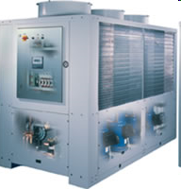

High Temperature Operation
Chiller-less data centers
  Less energy/materials, but space inefficient
High temperature operation of comm./computing equipment
  Smaller T_{outlet} – T_{inlet}
  Deal with occasionally hitting temp. limits.
Need smarter thermal adaptability

Slide 71


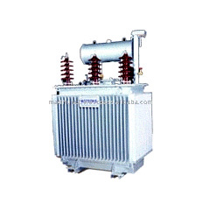

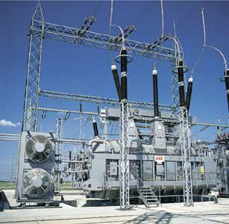
IT systems fed by Renewable Energy
Limit or eliminate energy draw from grid
  Less infrastructure & losses, but variable supply
  Need to consider impact on both computing & communications
Similar issues with unreliable grid supply
Need better power adaptability

Slide 72
Applications of Data Deduplication
and
Cloud Storage

Slide 73
Overview of Chunking Algorithms
Fixed-sized Chunking
Content-Defined Chunking

Slide 74
Data Structures Associated with Chunking Deduplication (stop)
After chunking
c1
c2
c1
c3
chunk list
ID1
loc(c1)
ID1
ID2
ID1
ID3
ID2
loc(c2)
ID3
loc(c3)
… …
c1
c2
c3
Index table
de-duplicated chunks (stored in chunk store)

Slide 75
Thank You!
Questions?

